Slide 1
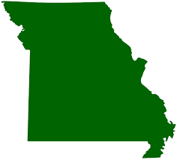
What’s Happening in Missouri?

Slide 2

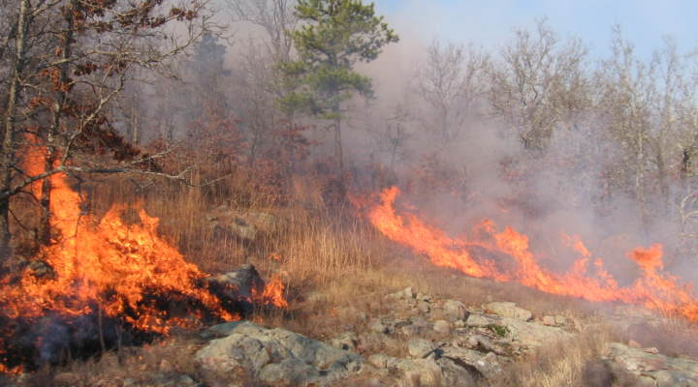
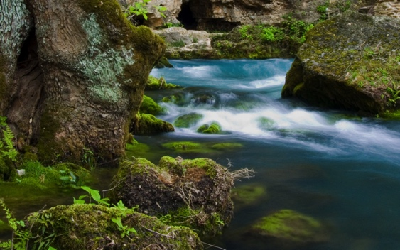
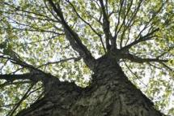
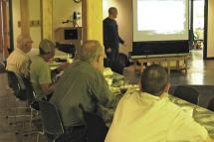
The Nature Conservancy “50 State Climate Initiative”
– MISSOURI PROGRAMS
MO Fire Program
Live trees trap carbon dioxide
Wildfires wipe out forests. . .
Prescribed burns and vegetation thinning create healthier forests
Current River Watershed Freshwater & Sustainable Forestry Program
Sustainable forest practices
Landowners can improve the health of their woodland, improve habitat for wildlife, and help keep water clean by reducing erosion and run-off

Slide 3
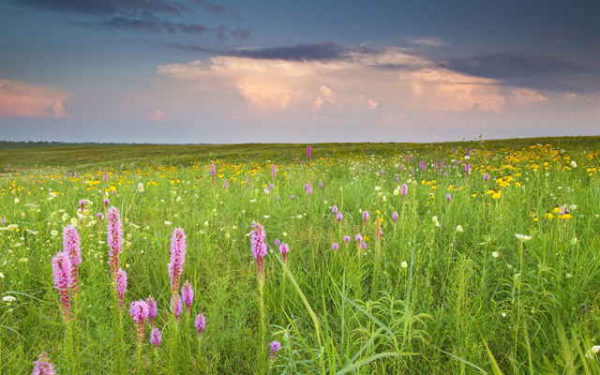
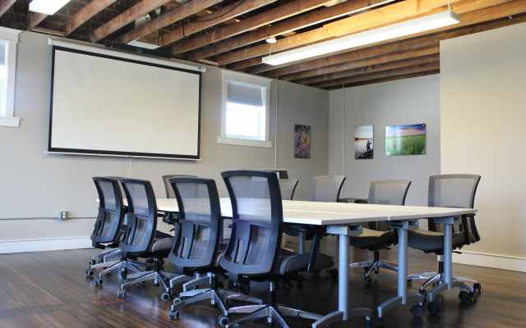
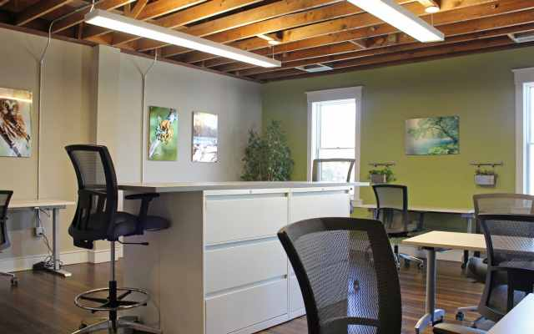
The Nature Conservancy “50 State Climate Initiative”
– MISSOURI PROGRAMS
Dunn Ranch Prairie
Grasslands have fabulous carbon storage
Drought tolerate native plants for ranchers
Plant more prairies!
St. Louis Office Goes Virtual
Moved into a smaller, more energy-efficient office space
Staff works from home most days

Slide 4
Where We’ve Been
Changes that have occurred
How scientists gather data
Management plans for
natural areas

Slide 5
Where We’re Headed
The Six Americas
Plan of Action
ACE activity
Talking Template
Message of Hope!

Slide 6

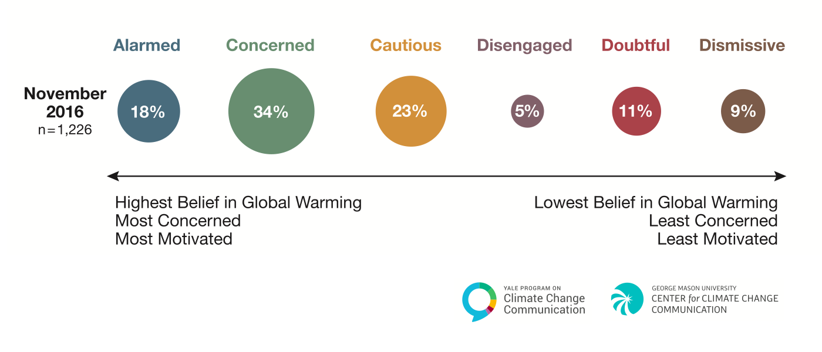
“Six Americas of Climate Change”

Slide 7
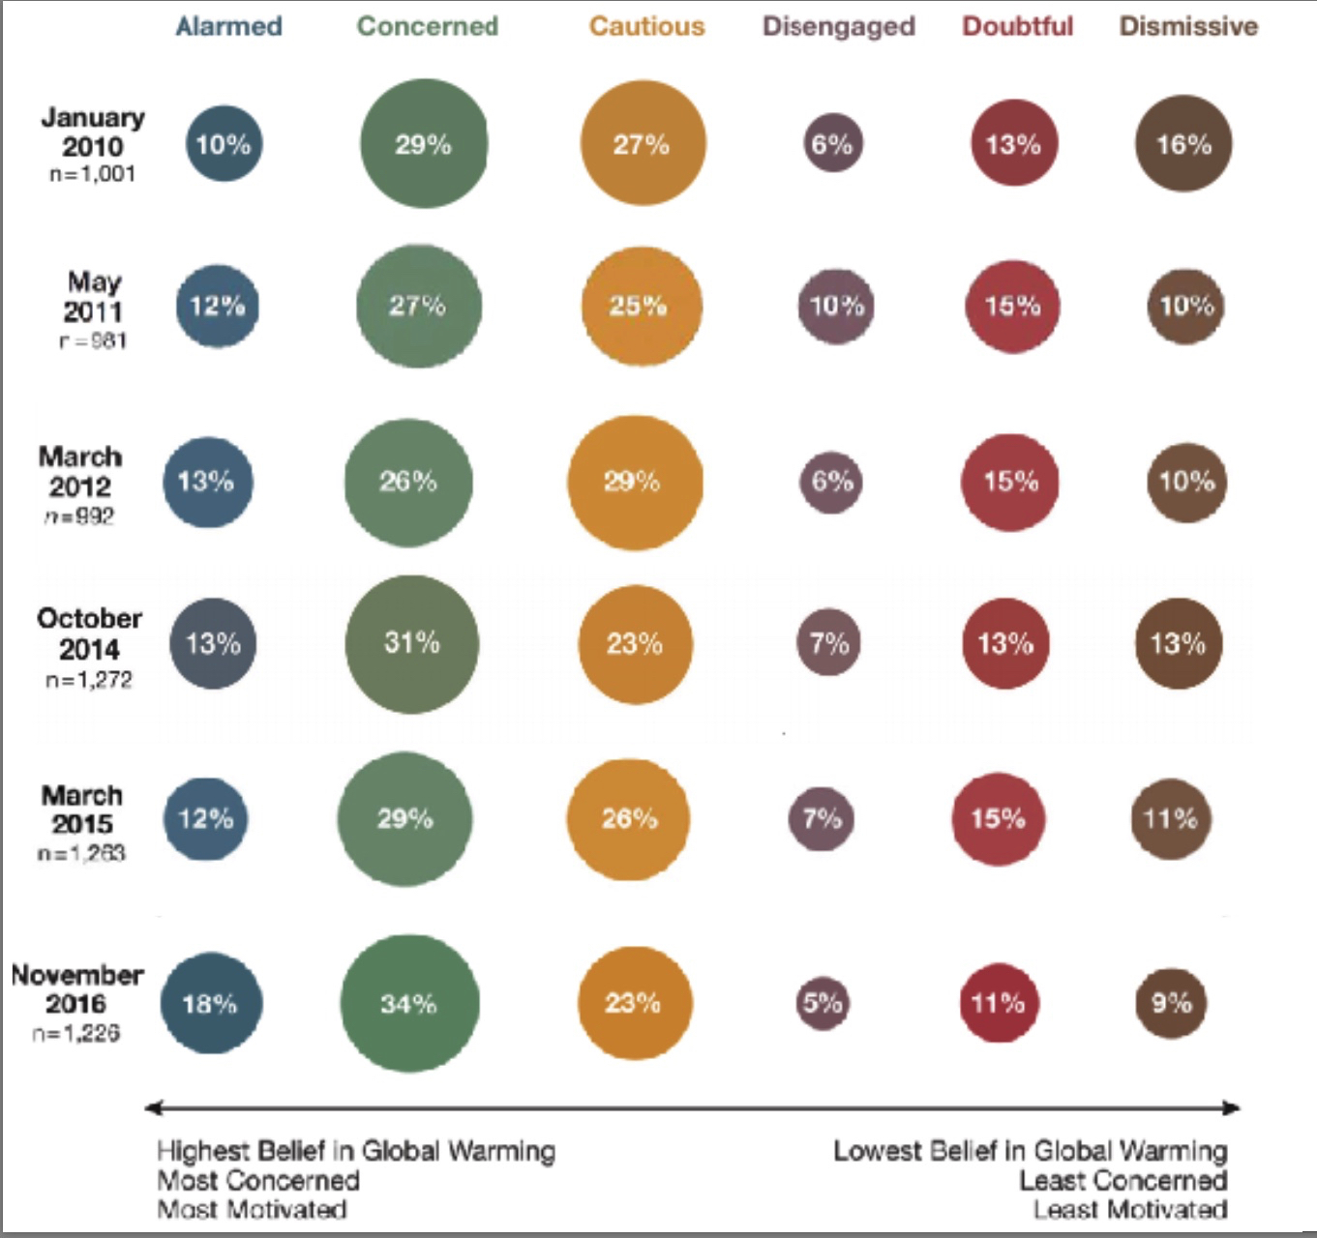

Slide 8
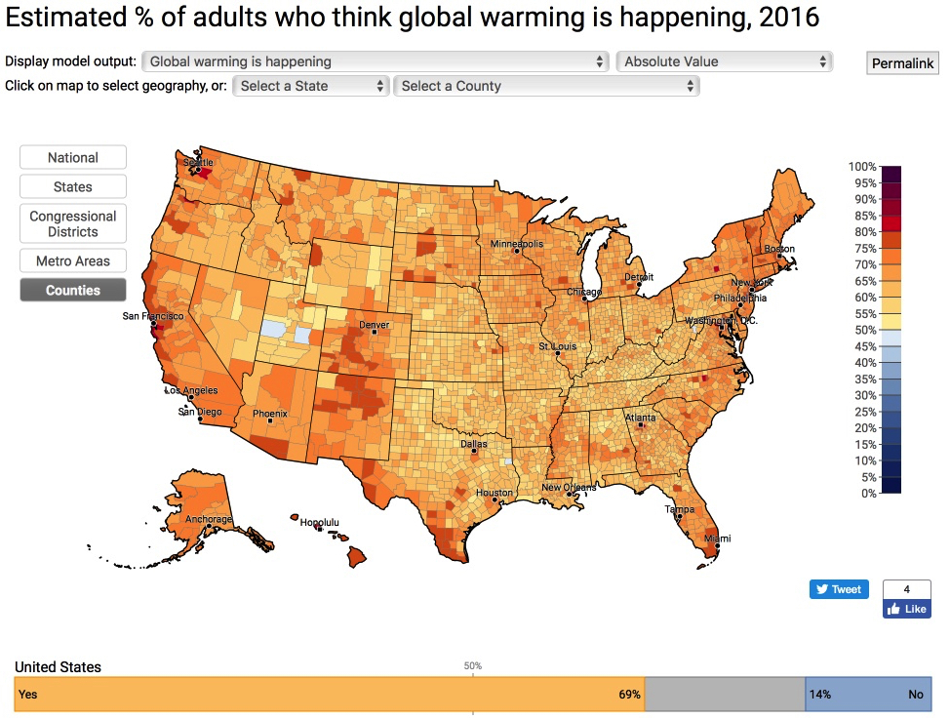
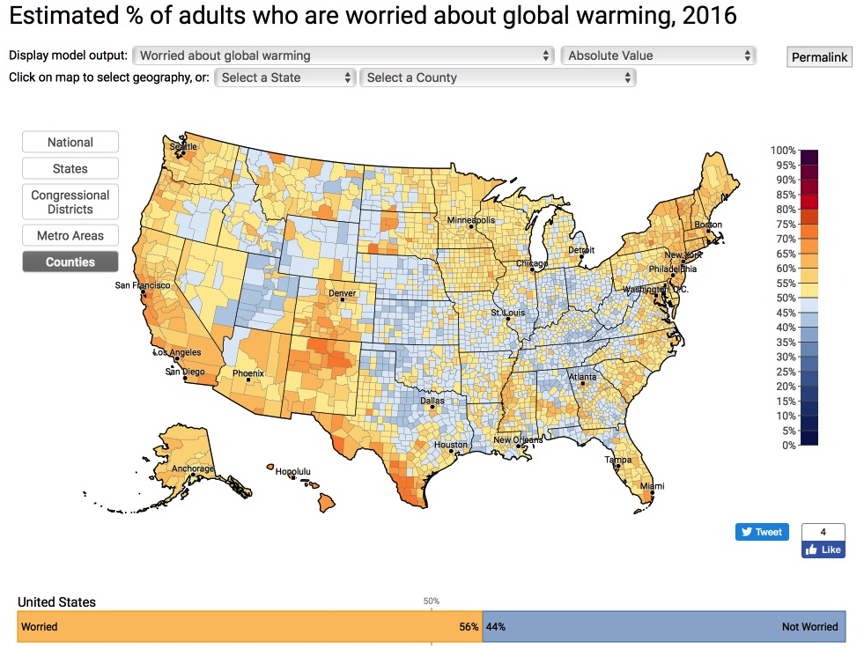
69%
56%

Slide 9
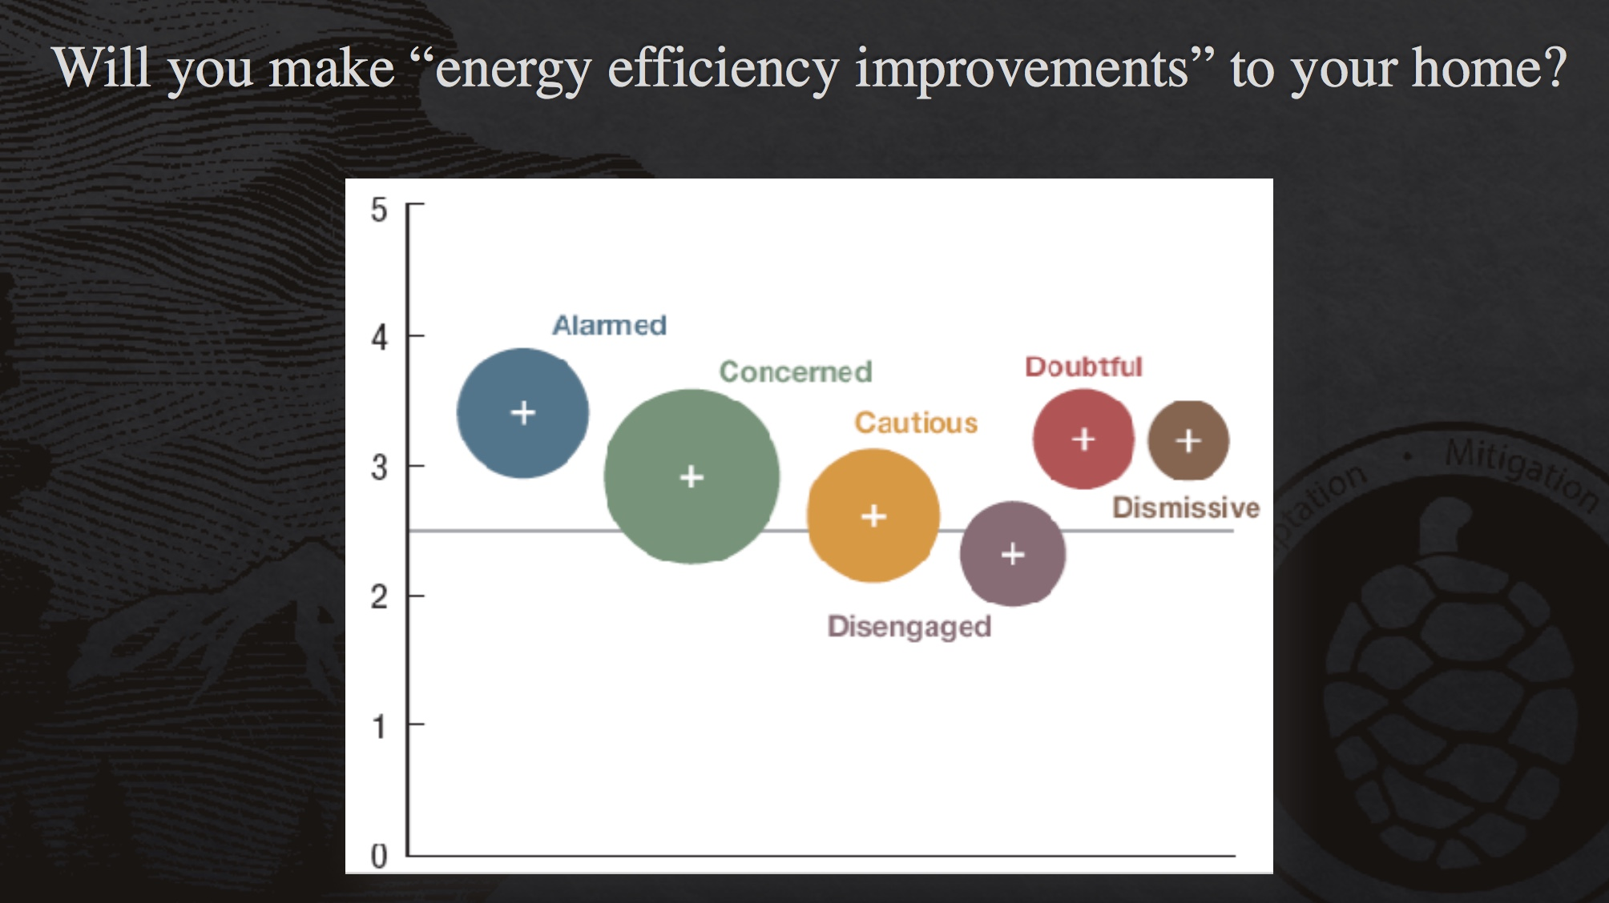

Slide 10

9.) Do you support funding research in renewable energy sources?
9.) Estimated % of adults who support funding research in
renewable energy sources

Slide 11
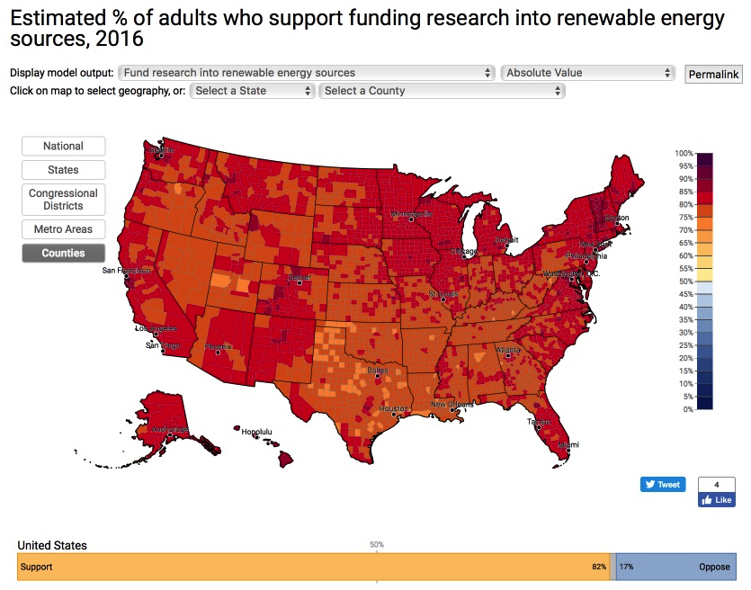
82% 9.) Estimated % of adults who support funding research in
renewable energy sources
82%

Slide 12
10.) Do you discuss global warming at least occasionally?
10.) Estimated % of adults who discuss global warming at
least occasionally

Slide 13
33% 10.) Estimated % of adults who discuss global warming at
least occasionally

Slide 14
Plan of Action
Continue to gather data and learn
Lifestyle changes
• Calculate your carbon footprint and do things to reduce it
• Less pollution – saving the “green” environment
    • Save money – saving some “green” in your pocket
3. Assist with Citizen Scientist projects
See handout for examples
of plans of action!

Slide 15

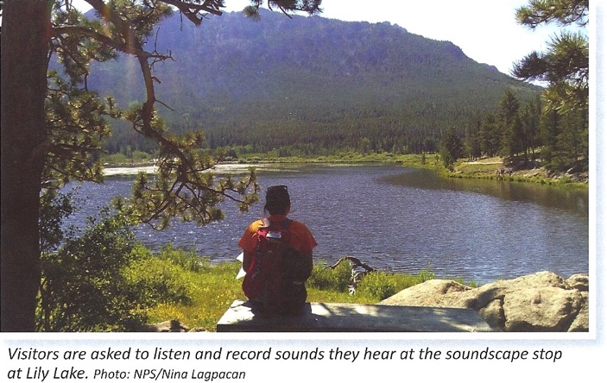
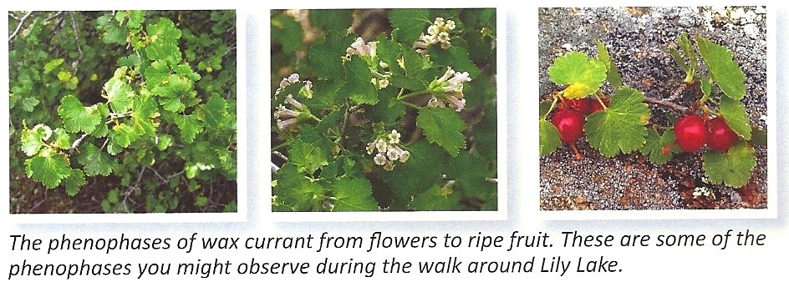
Rocky Mountain National Park
Lily Lake Climate Change Citizen Scientist Project
Using an app, record answers to questions
  Phenology
    “On this bush, do you see green leaves?”
    “On this bush, do you see ripe fruit?”
  Sounds that visitors hear (natural or human)
  Visibility data of Longs Peak compared to photos in the app
Over time, will determine if Spring is coming earlier, if air quality degrading, etc.

Slide 16
AUDIENCE CENTERED EXPERIENCE (ACE)
ACTIVITY TIME!

Slide 17
ACE Activity
Write answers to questions about your own opinions on climate change (handout)
Choose a “Stakeholder” that you do NOT associate with
Gather in a group of similar stakeholders
  Read more information on that particular stakeholder’s opinion (provided printout)
  Discuss stakeholder questions
Return to larger audience and have a representative from each stakeholder group summarize one “solution”

Slide 18
Answer the following for yourself:
Are changes occurring in the climate?
How do you form your opinions?
Where can you go for non-biased information?
What is your plan?

Slide 19

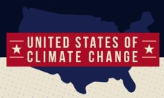
STAKEHOLDERS
Farmer
Construction Company
Climate Change Skeptic
Health Care Provider
Non-profit Relief Organization
Coal Power Plant Worker
Coastal Timeshare Owner
Financial Investors
Stakeholder detailed information gathered from a special feature on Climate Change from the Weather Channel.

Slide 20
Don’t forget:
    Not here to “convert”
    Not political
    Here to be respectful of others’ opinions

Slide 21
QUESTIONS
What values or beliefs might be the foundation of the stakeholder’s point of view?
Which beliefs of the stakeholder do you think are substantiated
by evidence?

Slide 22
QUESTIONS
In your opinion, which beliefs, if any, are unsubstantiated by the stakeholder?
What, if anything, in the point of view of the stakeholder, challenges your own personal assumptions?

Slide 23
QUESTIONS
What solution(s) might the stakeholder propose? What counter-arguments would you expect from other stakeholder groups?
    Please be prepared to share one possible solution with the larger audience.

Slide 24
Break up into Stakeholder groups
  (About 15 minutes)
Return to larger audience for:
  Brief discussion of “ACE”
  Talking Template
  Message of hope!

Slide 25
STAKEHOLDERS
Farmer
Construction Company
Climate Change Skeptic
Health Care Provider
Non-profit Relief Organization
Coal Power Plant Worker
Coastal Timeshare Owner
Financial Investors
Stakeholder detailed information gathered from a special feature on Climate Change from the Weather Channel.

Slide 26
Talking Template By Dr. Katharine Hayhoe

Slide 27
HOPE!
More than 6 million metric tons of plastic packaging per year are produced by these 11 companies
Recently, they all have committed to using only reusable, recyclable or compostable packaging by 2025!!!
Amcor packaging manufacturer
Ecover household cleaning products
Evian bottled water
L'Oréal cosmetics
Mars candy, beverages, food, and petcare
M&S clothing, home products, and luxury food products
PepsiCo beverages, food, and snacks
Coca-Cola beverages
Unilever beverages, food, cleaning products, and personal care products
Walmart superstores, discount department stores, and grocery stores
Werner & Mertz commercial and household cleaning products
Ellen MacArthur Foundation

Slide 28
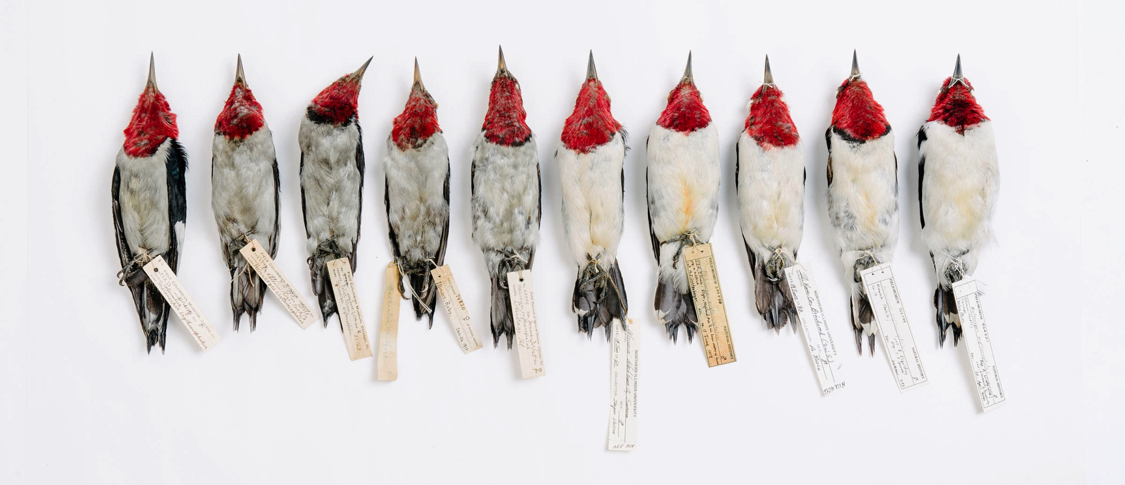
HOPE!
Red-headed Woodpeckers in chronological order from 1880 to 2015
Field Museum in Chicago. Photo: Tristan Spinski

Slide 29
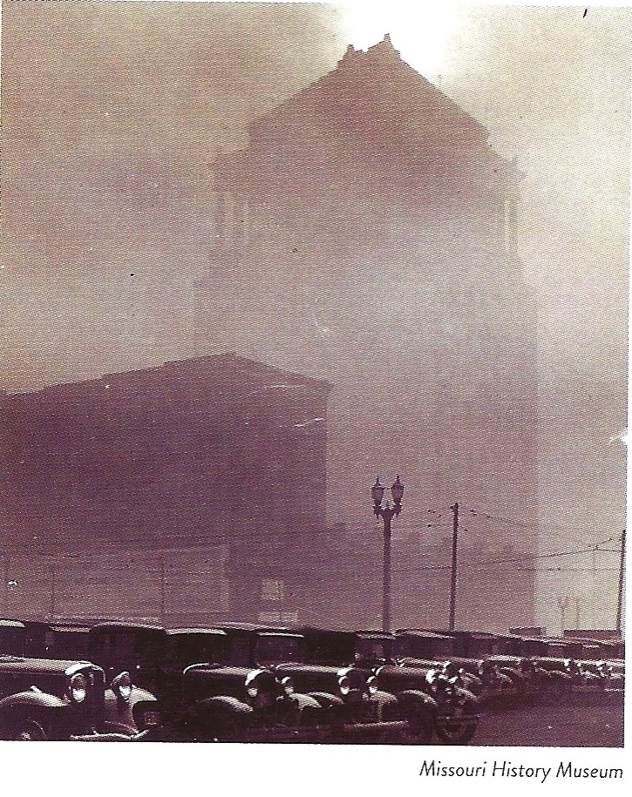
Mid-Day
February 13, 1936
Downtown St. Louis

Slide 30
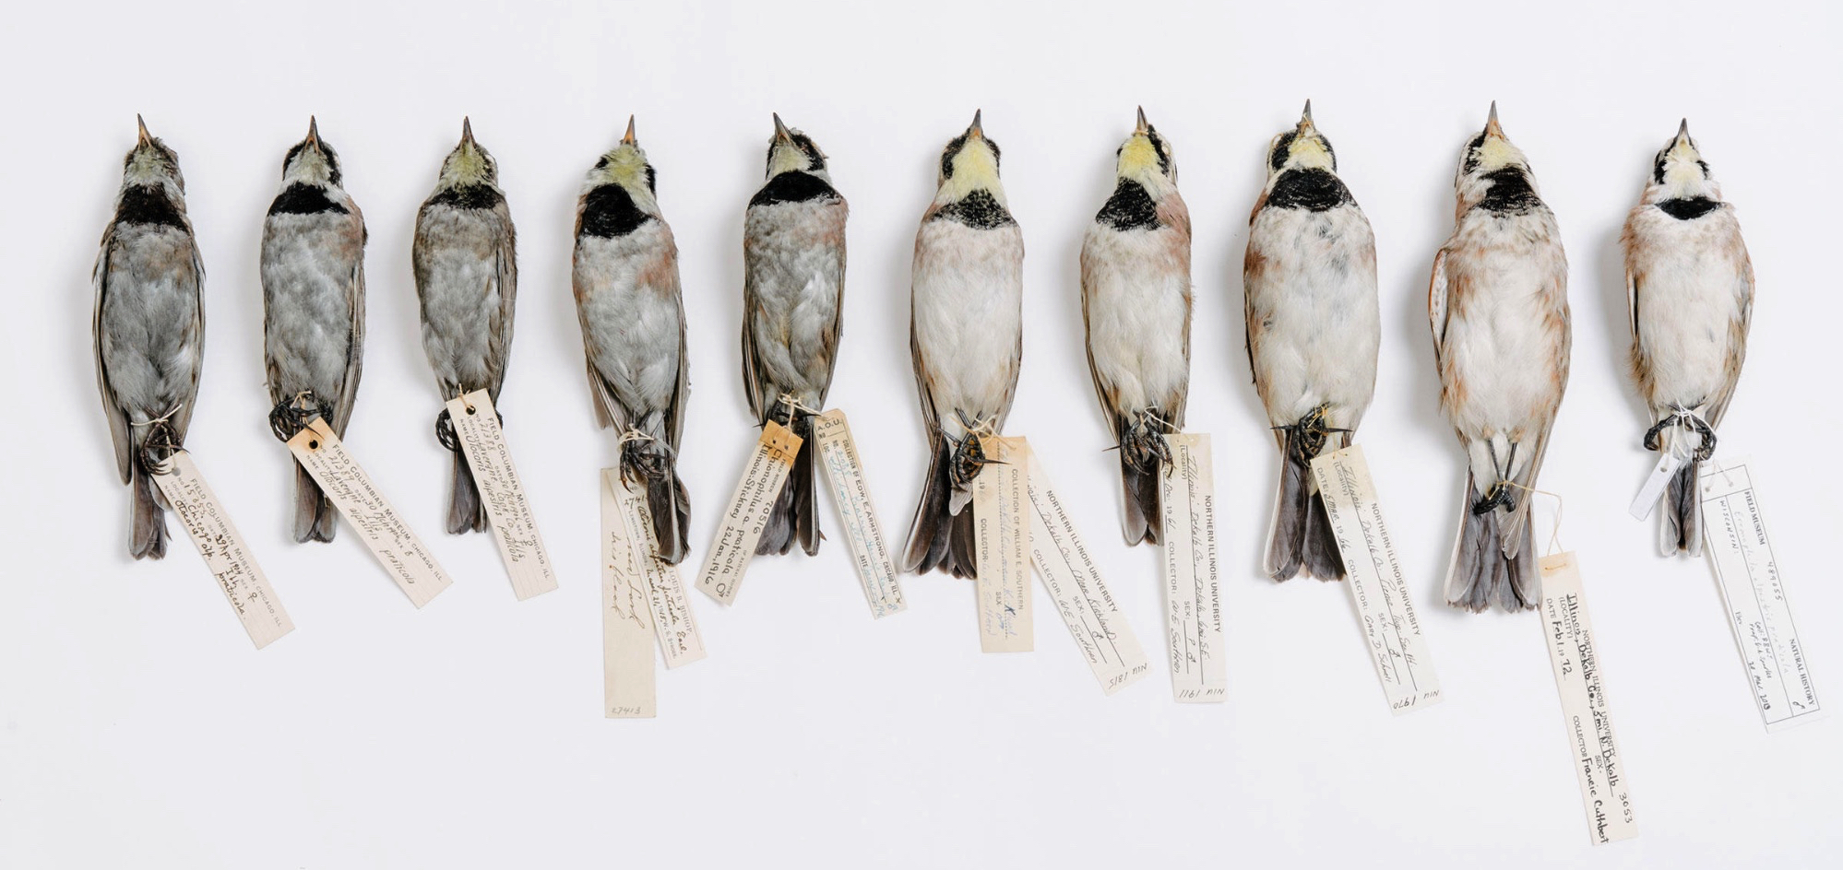
Horned Larks in chronological order
from 1880 to 2015
Field Museum in Chicago. Photo: Tristan Spinski
We DO have the ability to recognize a problem
– and fix it!

Slide 31
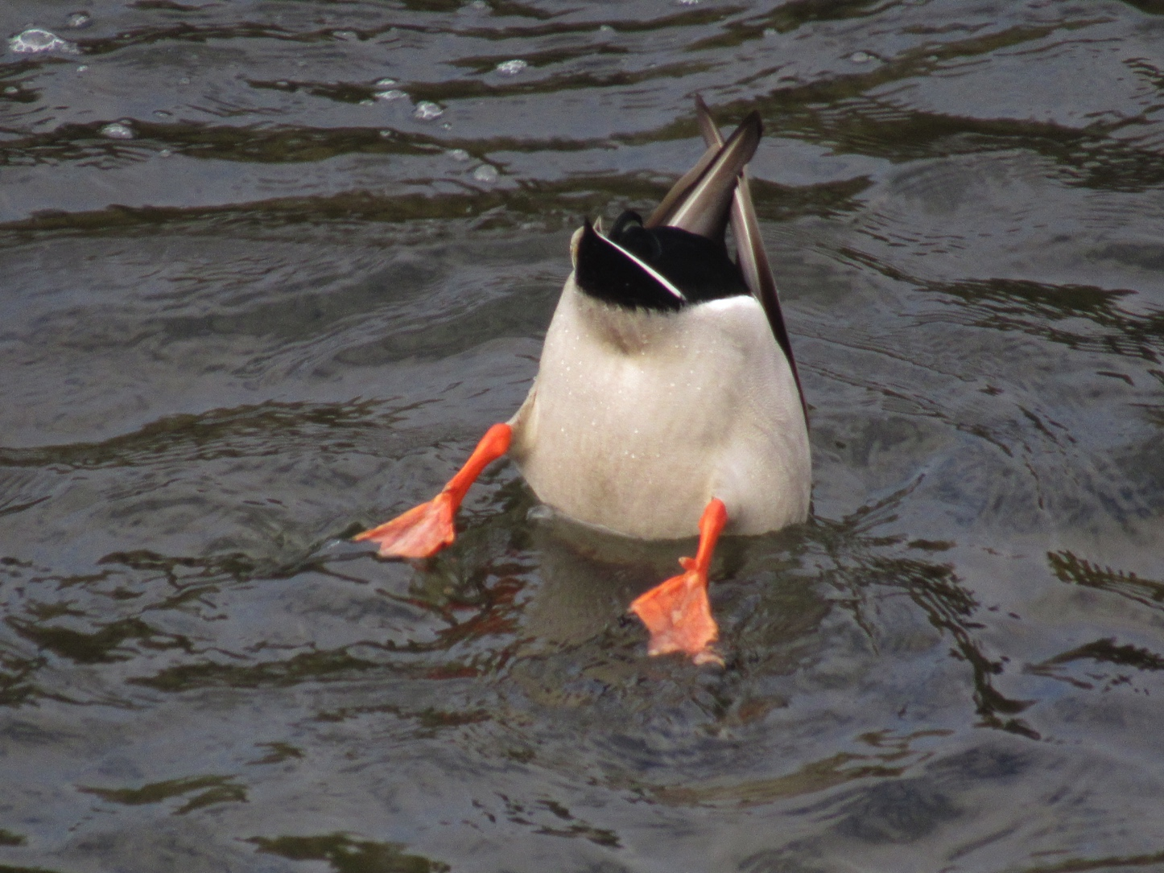
The End!
Thank you!
Aaron Jungbluth

