Slide 1
CARBON ACTIVITY TIME!

Slide 2
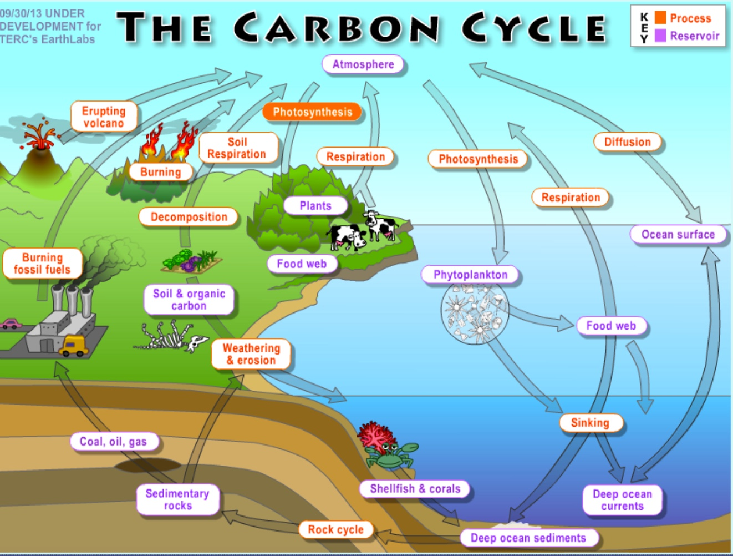
Earth’s System Processes Take Place
on Both Local and Global Scales

Slide 3
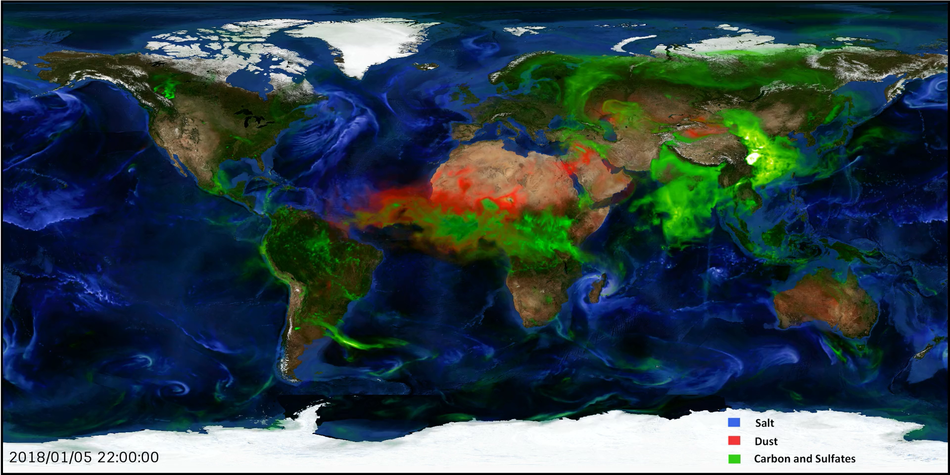
GLOBAL MOVEMENT OF CARBON (green)
NASA

Slide 4
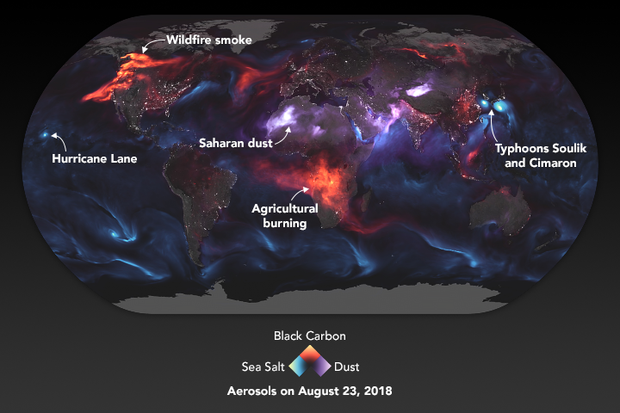
NASA

Slide 5
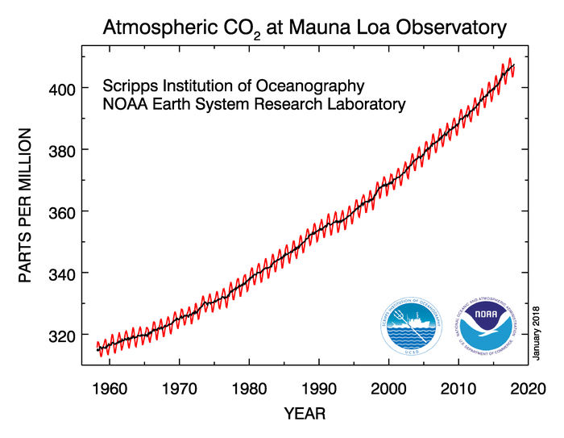
Coal burning produces 25% of all of world’s carbon emissions
In 2015, 5.2 million acres burned in Alaska alone
Projection: 2 billion passenger vehicles on the roads by 2055

Slide 6


Anybody planning to save some green in the environment?

Slide 7
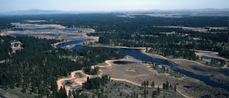
TURNBULL NATIONAL WILDLIFE REFUGE
Cheney, Washington
Interesting Management Strategy. . .

Slide 8
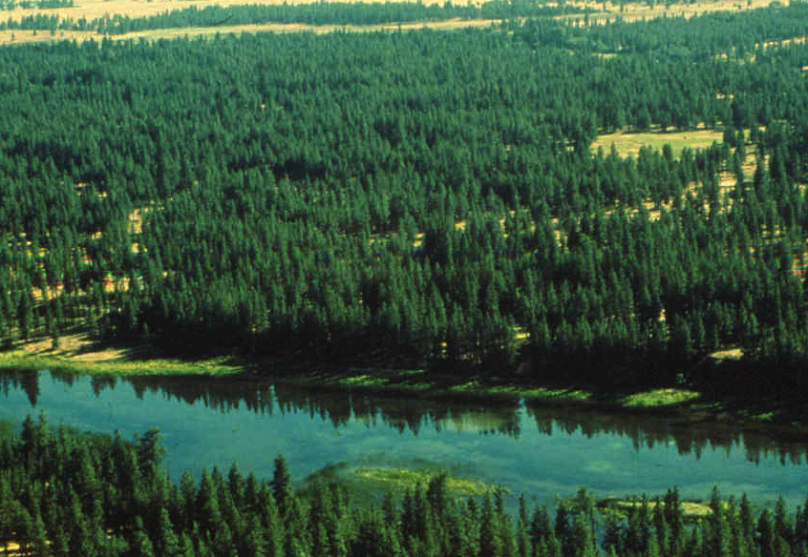
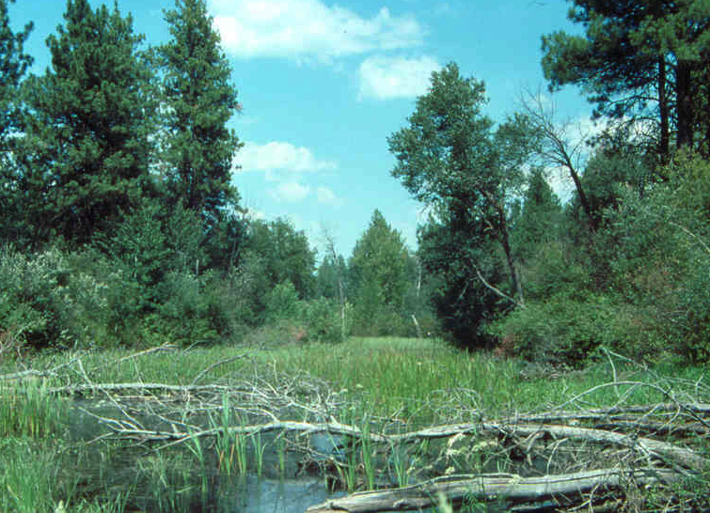
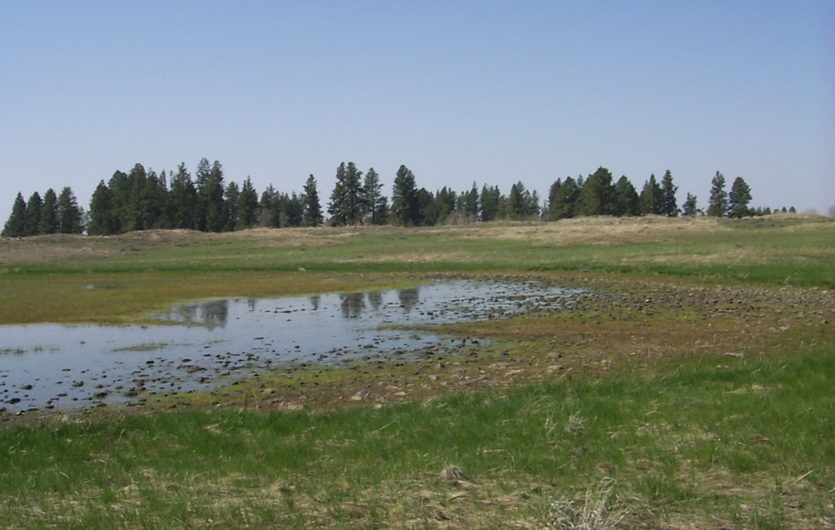
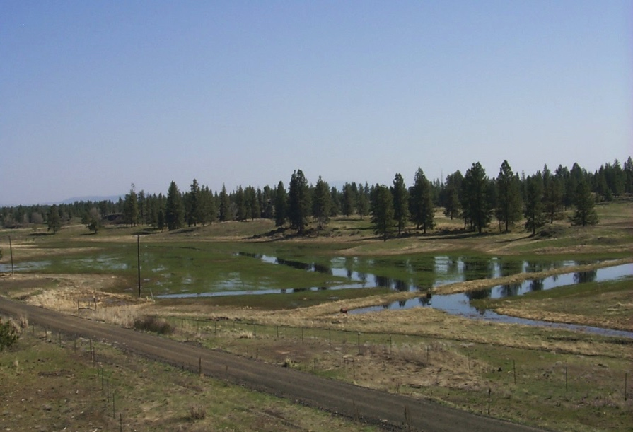
Deep Lakes / Sloughs
Wetlands
Potholes
Vernal Pools
Altered Wetlands
Notes:
There are 4 major wetland n configurations in the Scablands .
Deep Permanent Wetlands Slough and Lakes with a large percentage of open water present yearround. These wetlands can be more than 500 acres in size. Many receive groundwater from springs erupting from exposed water bearing strata of basalt in deeper flood channels
Smaller and more seasonal potholes occur in more elevated postions in the scablands an drainage in size from less than .1 of an acre to over 20 acres. These are typically perched above the local water table and are filled primarily through snowmelt in February and March .
In the most elevated portions of scablands and often found near the edge of the flood tracts are vernal pools that seldom stay flooded beyond 2 months in the spring. These wetlands are host to unique floral and invertebrate communities.
The forth type is by far the most abundant. These are the wetland basins altered through ditching to reclaim tem for farming and pasture. These basins still flood in the spring, but go dry by June to early July. These wetlands are often dominated by the invasive reed canarygrsas.

Slide 9
Wetland Non-climate Stressors
Pollution
Invasion by exotic plant and animal species
Reduced watershed yield as a result of greater conifer forest cover
Wetland Management Practices

Slide 10
What’s Interesting?
Wetland Planning and Managing for Expected Climate Changes

Slide 11
Anticipating Changes . . .
Increase in temperature
  Increase in evapotranspiration resulting in more rapid summer drawdown
Little change in annual precipitation, but precipitation likely to come mostly in the form of rainfall with less snowpack
  Snowfall accumulation especially in late winter is a significant source of wetland recharge

Slide 12
Long-term Adaptation Strategies
Prioritize wetland management
  Pass run-off through to priority wetlands
Augment natural wetland inputs
  Groundwater pumping
  Tertiary treated wastewater
Facilitate wetland transition to more xeric habitat type that provides important ecosystem functions
  Aspen and Deciduous Shrub Communities
  Transporting Species

Slide 13
