Slide 1

We have just discussed changes concerning animals and habitat.
What about the people?

Slide 2


7.) Do you think global warming is already harming people
in the United States now or within 10 years?
7.) Estimated % of adults who think global warming is already
harming people in the United States now or within 10 years

Slide 3
49% 7.) Estimated % of adults who think global warming is already
harming people in the United States now or within 10 years

Slide 4

American Red Cross did more work with disaster relief efforts in 2017
than the last 4 years combined.
Was last year simply extreme weather or is there something else going on?

Slide 5
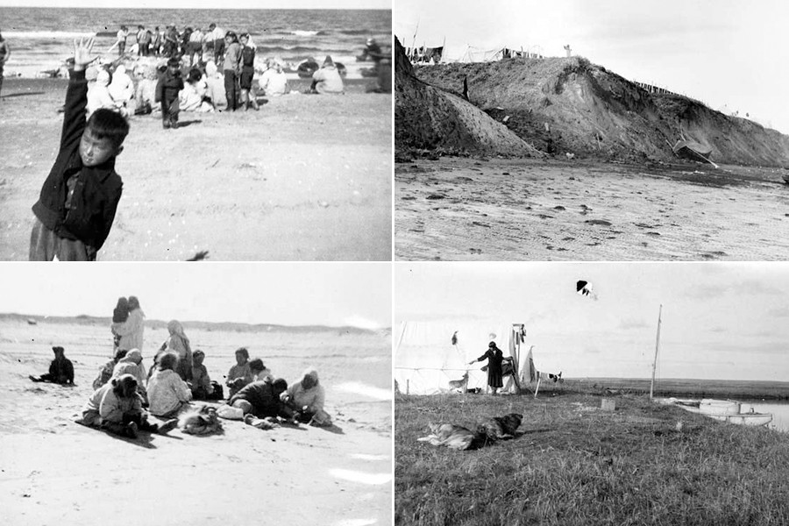
Sarichef Island, Alaska
Inhabited for 400 years
NOAA – Pacific Marine Environmental Laboratory (PMEL)

Slide 6
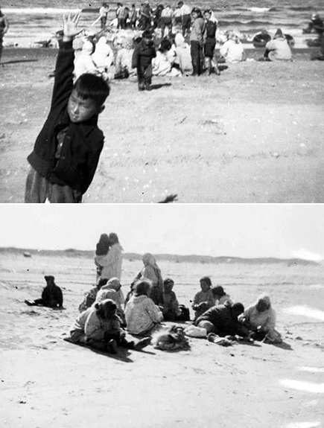
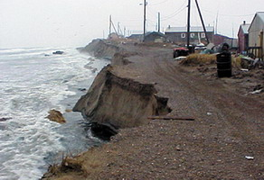
Sarichef Island, Alaska
What is the difference?
NOAA – Pacific Marine Environmental Laboratory (PMEL)

Slide 7
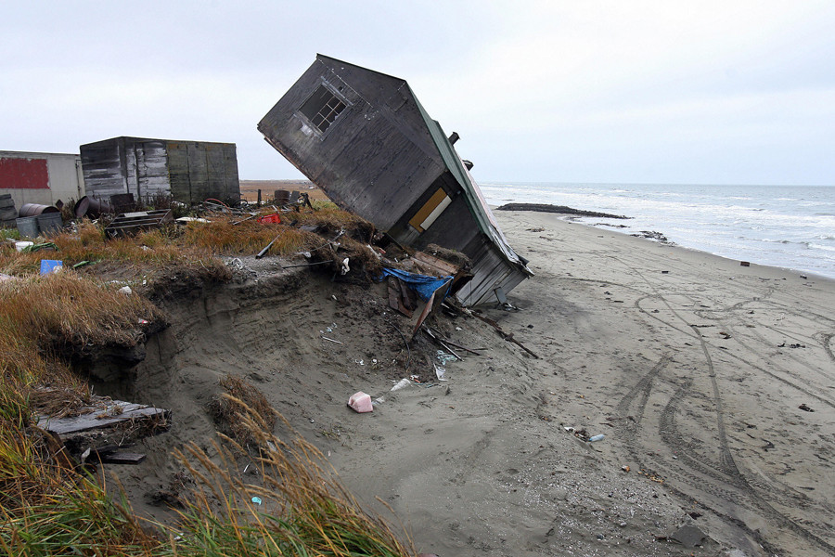
Sarichef Island, Alaska
Facing evacuation – “Climate Refugees”
  Sea levels rising
  Reduced sea ice causing higher storm surges
  Thawing permafrost causing erosion
NOAA – Pacific Marine Environmental Laboratory (PMEL)

Slide 8
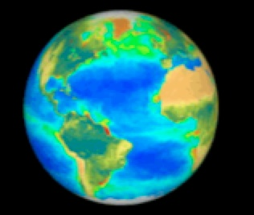
How do scientists gather data
to study climate?

Slide 9
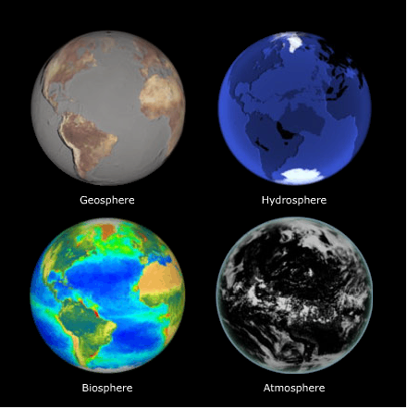
Four of Earth’s System Components
(or “Spheres”)
Earth is a system made up of multiple interconnected components.
Image credits: Jennifer Loomis, TERC/Biosphere image provided by ORBIMAGE © Orbital Imaging Corporation. Processing by NASA Goddard Space Flight Center. Image source: Exploring Earth

Slide 10
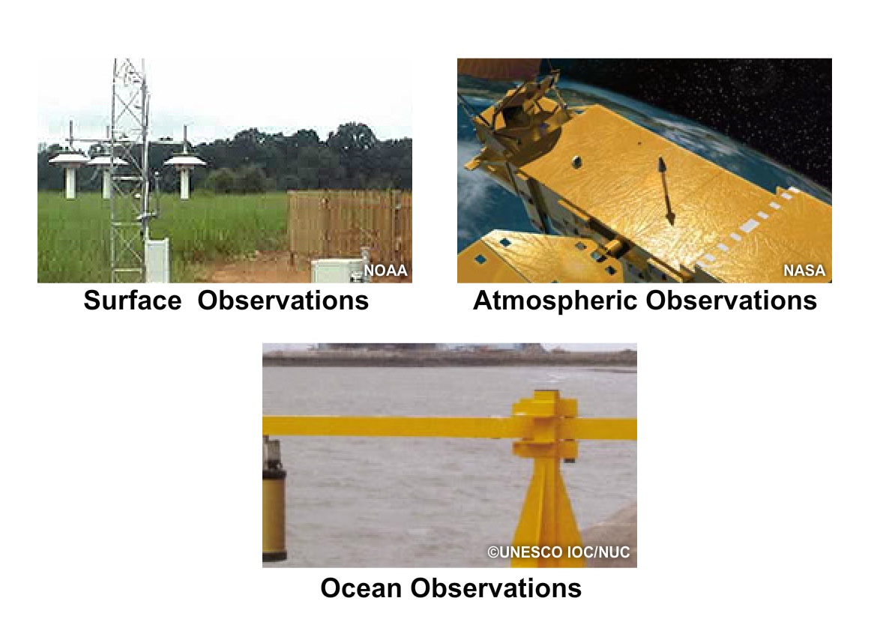
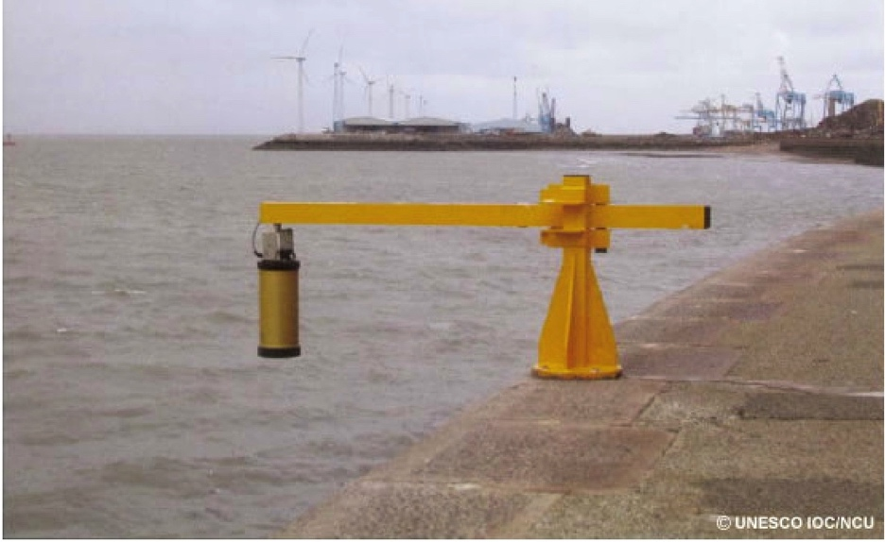
Current Climatological Data Gathering

Slide 11
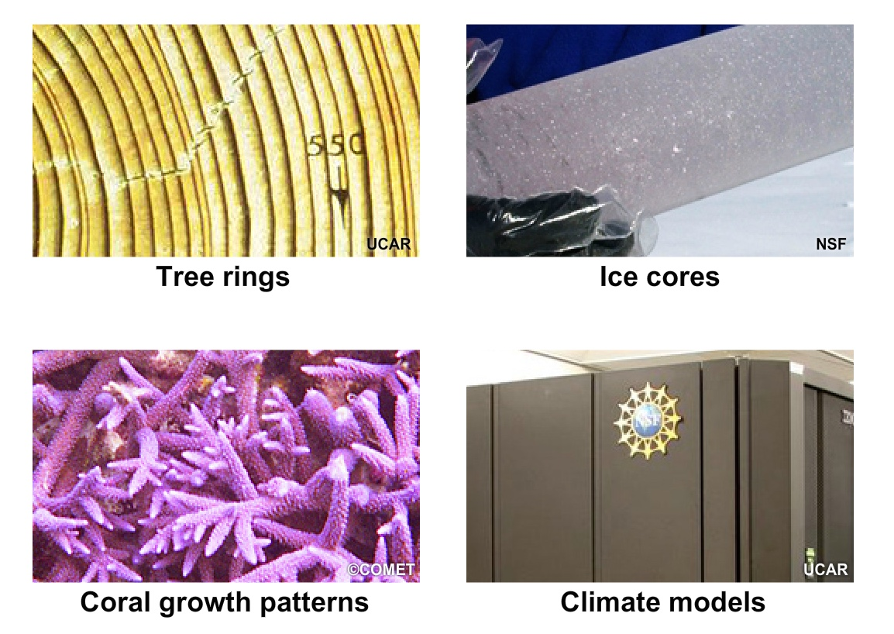
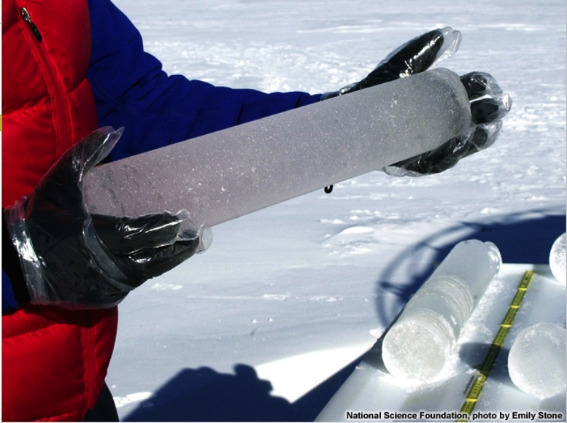
Historical Climatological Data Gathering

Slide 12
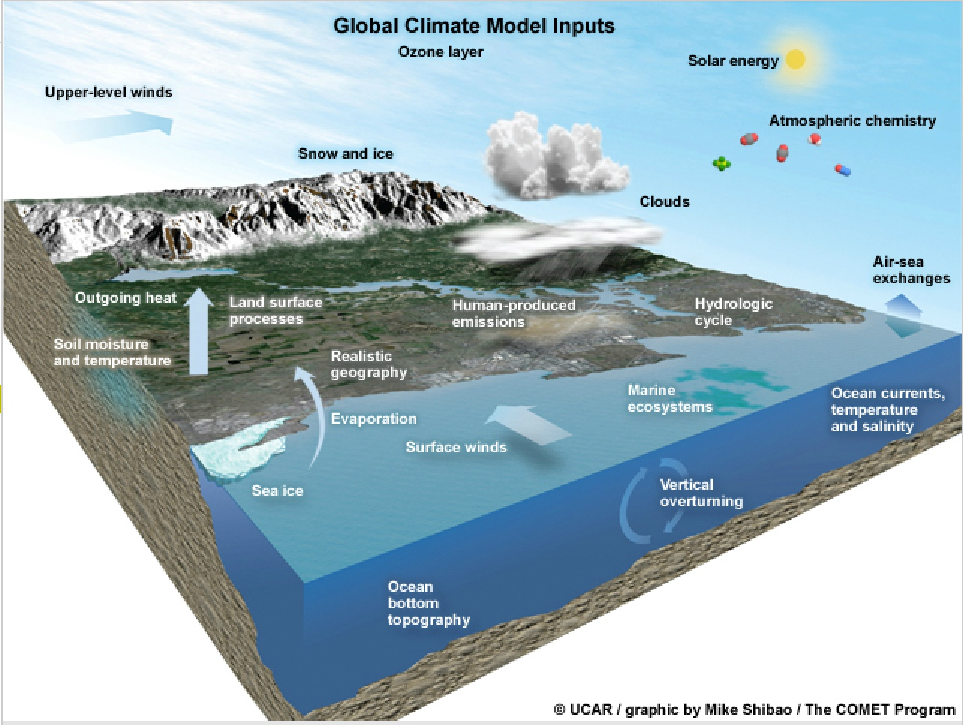

Slide 13
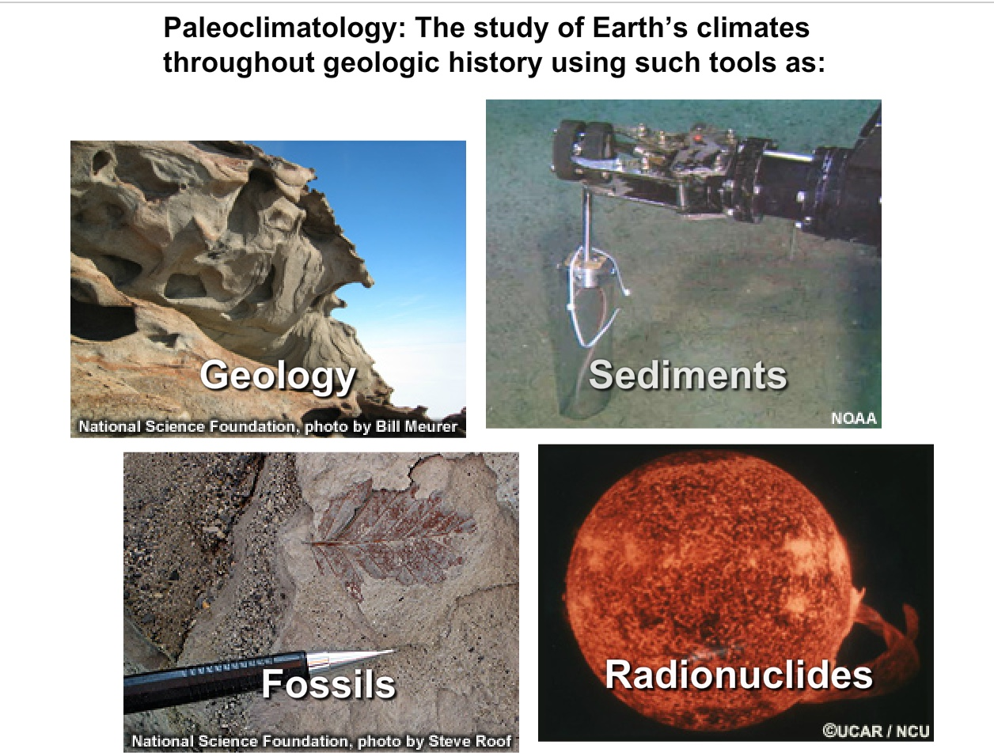

Slide 14
Suspicious about all of these changes?
Suspicious about the data?
Seek out the experts. . .
Look for non-biased resources
focused on the study of climate

Slide 15

Earth to Sky Partnership
  Collaboration of NASA, NPS, and USFWS
  “.org” so not directly affiliated with the U.S. Government
  Earth to Sky charter states they are not to market themselves

Slide 16

Intergovernmental Panel on Climate Change • Established in 1988
    2,000 specialists from over
    140 countries
    Does not gather data, but performs peer reviews of others’ information

Slide 17
See the handout for these and more websites to gather information!

Slide 18

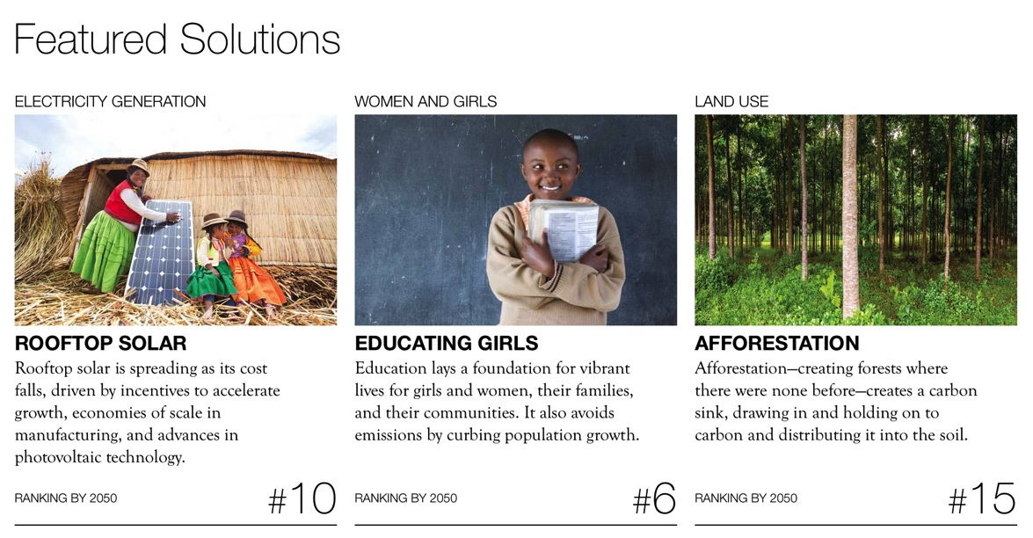
Great resource for projects:
Drawdown.org

Slide 19
Become educated…
Find data from both sides of the story
For instance:
Marc Morano with ClimateDepot.com and interviewed in the Merchants of Doubt documentary
Jimmy Hogan of The Rational Environmentalist

Slide 20

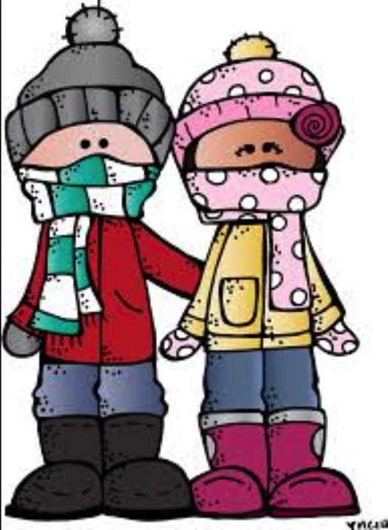
Climate are the types of clothes in your closet.
Weather is the clothing that you wear that day.

Slide 21
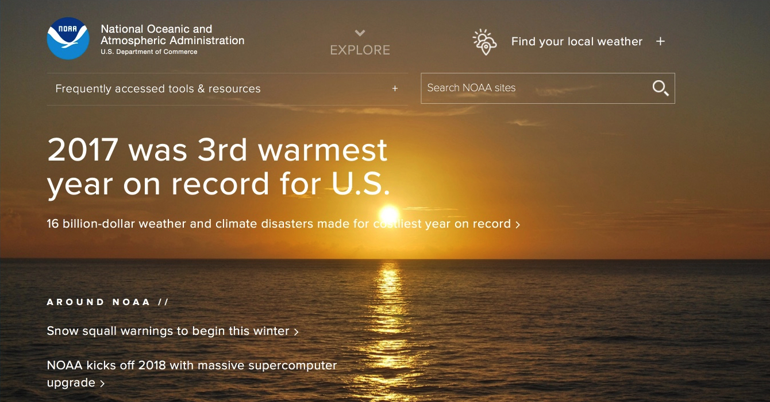
WEATHER
In Europe, 2013 was the warmest summer in the past 2,000 years

Slide 22
Extreme heat events occurred about every 20 years, but could become every 3 years by 2050.
If this becomes the new pattern over time, then this indicates a change in the climate. . .

Slide 23
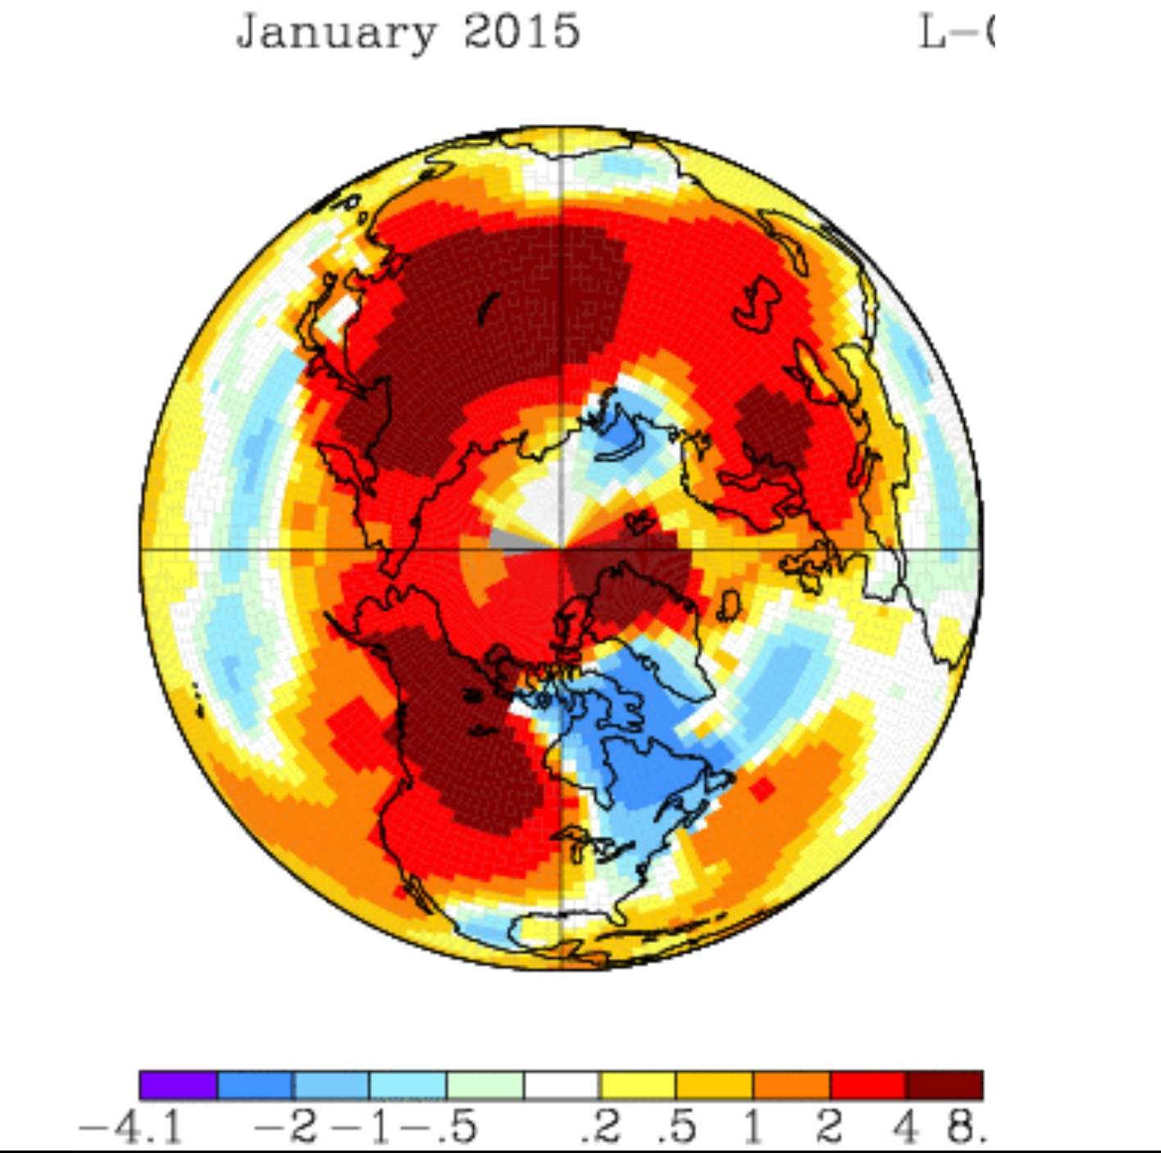
Look beyond your own backyard…

Slide 24
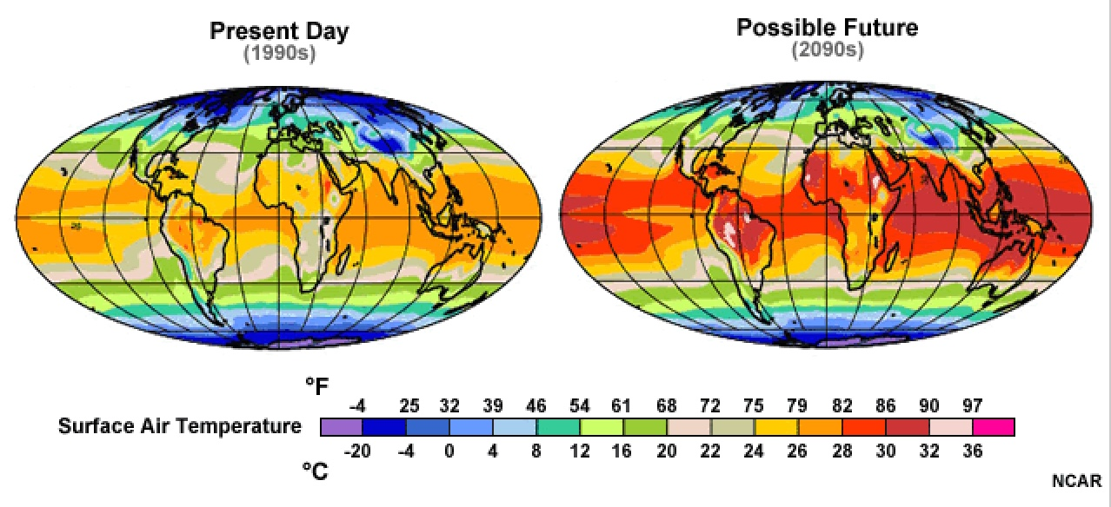
Average Surface Air Temperature

Slide 25
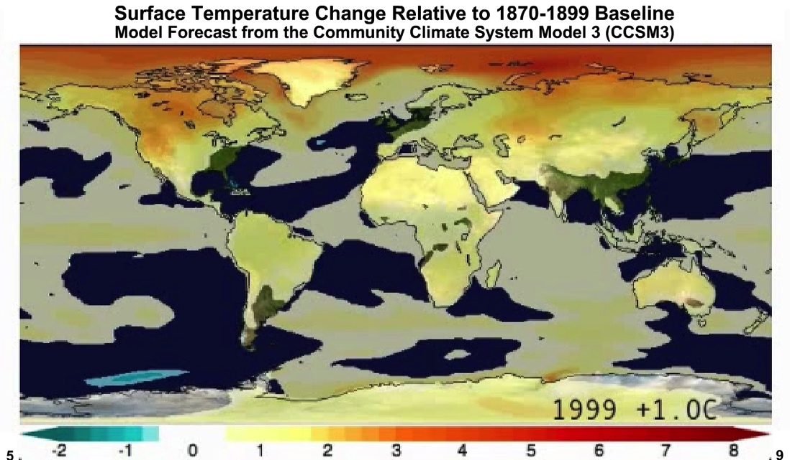
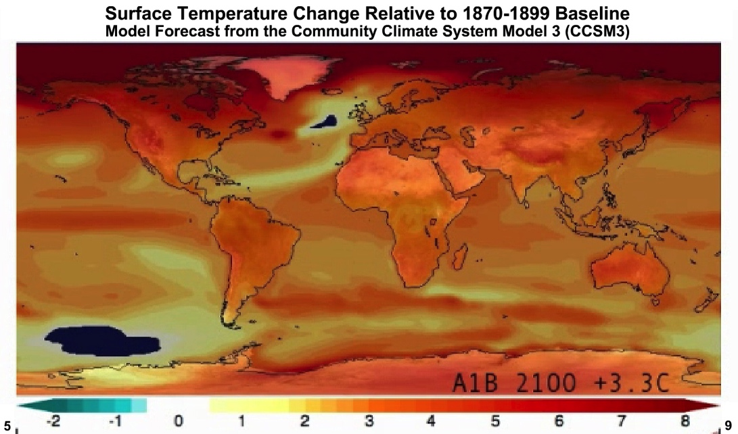
AMOUNT OF TEMPERATURE CHANGE
https://www.meted.ucar.edu/broadcastmet/climate/media/flash/warming_projection.swf
Arctic surface air temperature is warming twice as fast as rest of world
Autumn Arctic Ocean ice cover is rapidly declining 13% per decade
Climate models predict an ice free Arctic Ocean between 2030 and 2080

Slide 26
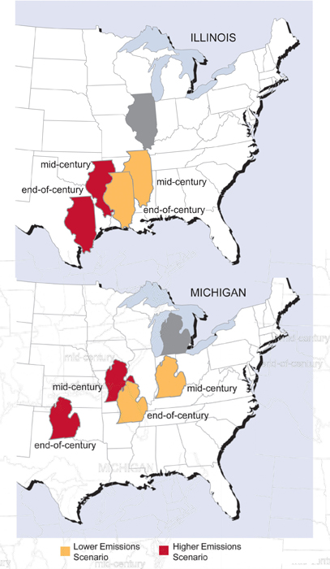
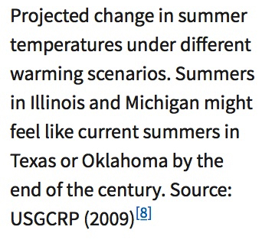

Slide 27
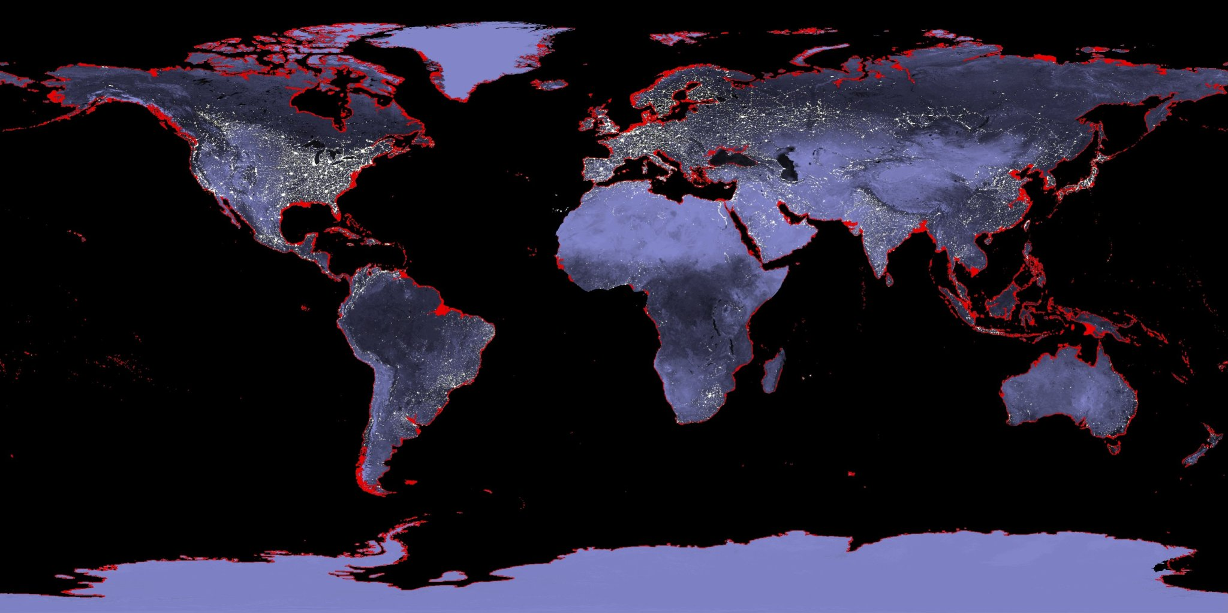
If average global temperatures rise 3-5 degrees F, the sea levels could rise 20 feet (levels from about 3 million years ago)
Not only by melting glaciers, but warmer water takes up more volume
NASA

Slide 28
Isn’t this just natural cycles?
Milankovitch Cycle take 1000s of years for cycle to complete
In the 20th Century, warming 10 times faster than the warming after the last Ice Age
Solar and volcanic activities over the last 50 years should have cooled the Earth, but instead the Earth’s global temperature is increasing

Slide 29
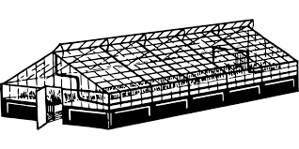
What are some examples of greenhouse gases?

Slide 30
Some of the Greenhouse Gases
Natural
  Water
Natural and human industrial activities
  Carbon Monoxide
  Carbon Dioxide
  Methane
  Nitrous Oxide
Human industrial activities only
  Sulfur Hexafluoride
  Carbon Tetrafluoride

Slide 31
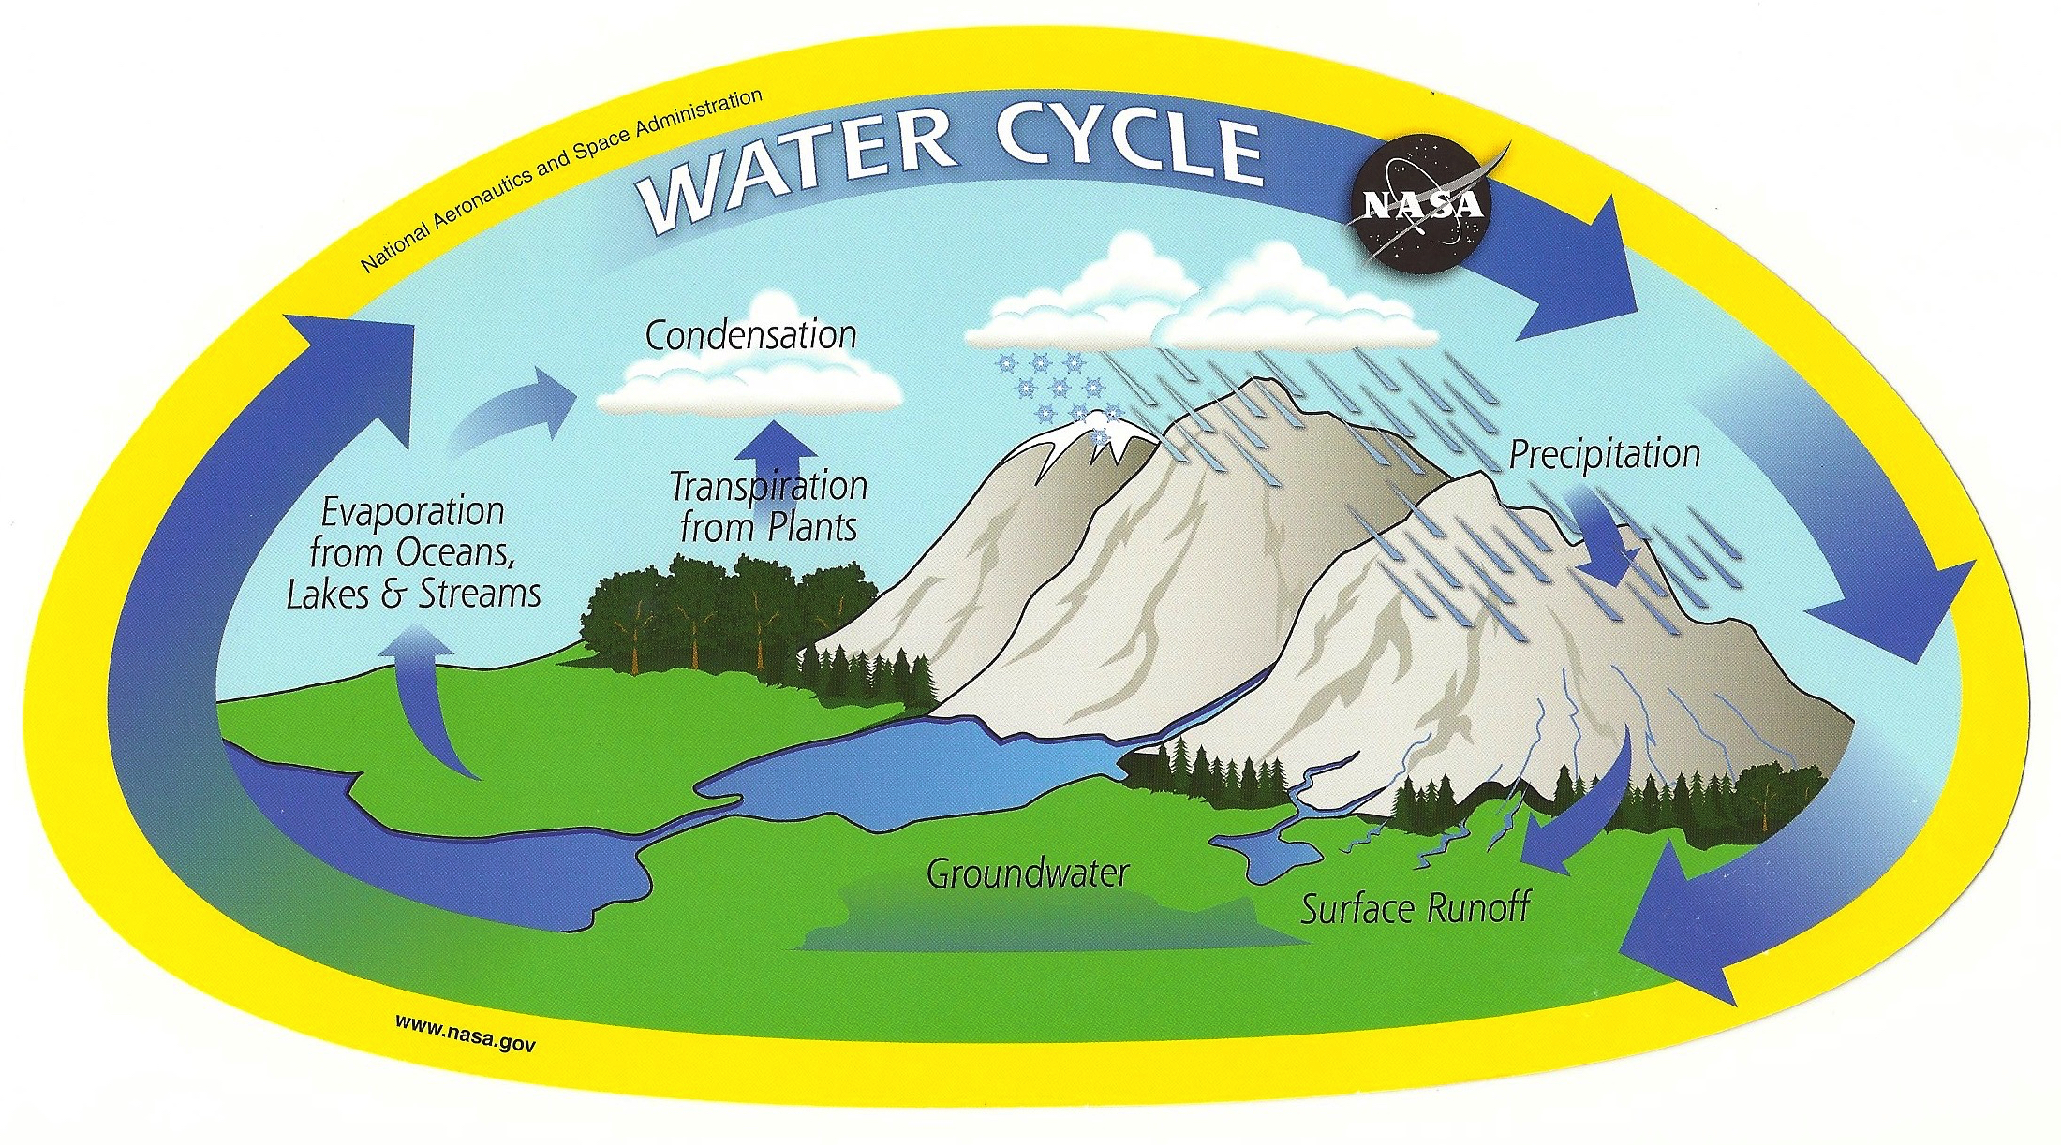

Slide 32
8.) Do you support regulating CO₂ as a pollutant?
8.) Estimated % of adults who support regulating CO₂ as a pollutant

Slide 33
74% 8.) Estimated % of adults who support regulating
CO₂ as a pollutant

