Slide 1

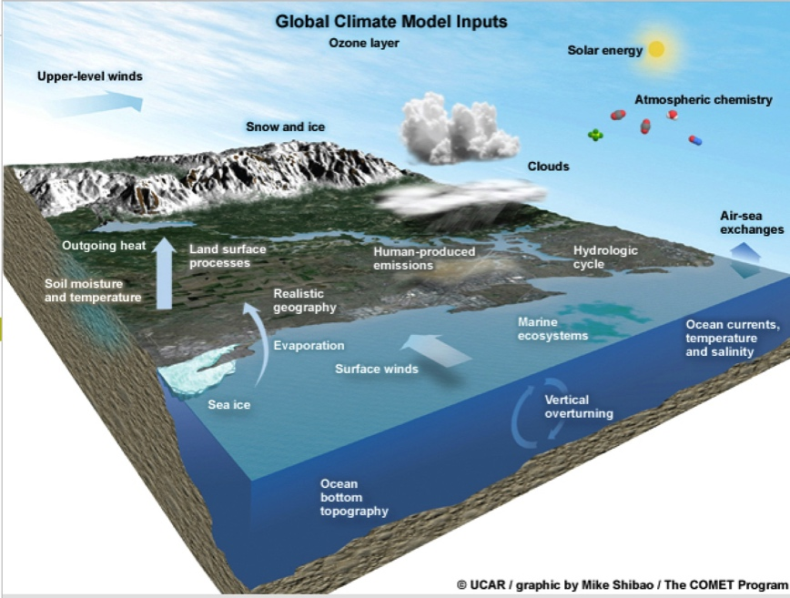

Want To Save Some Green?
Aaron and Angie Jungbluth
Volunteer Conservation Naturalists
Certified Interpretive Guides

Slide 2




Slide 3
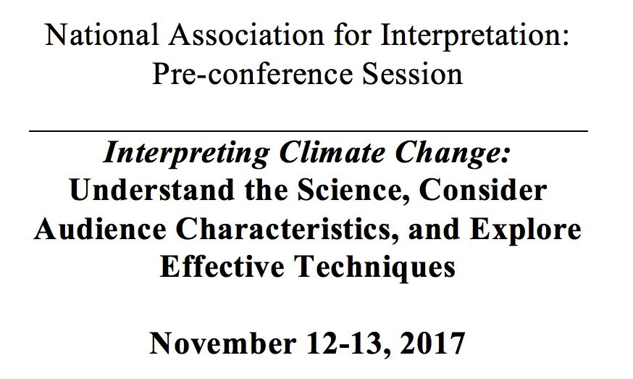
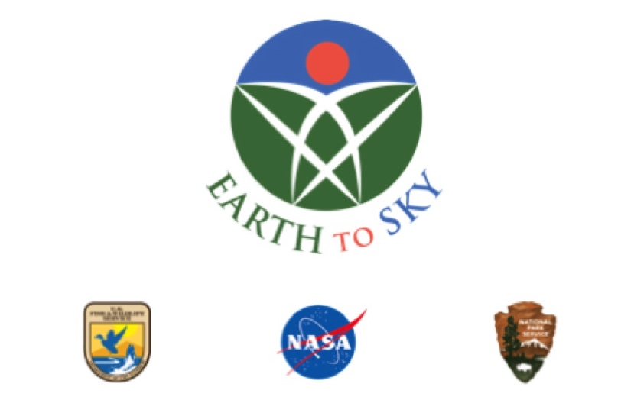

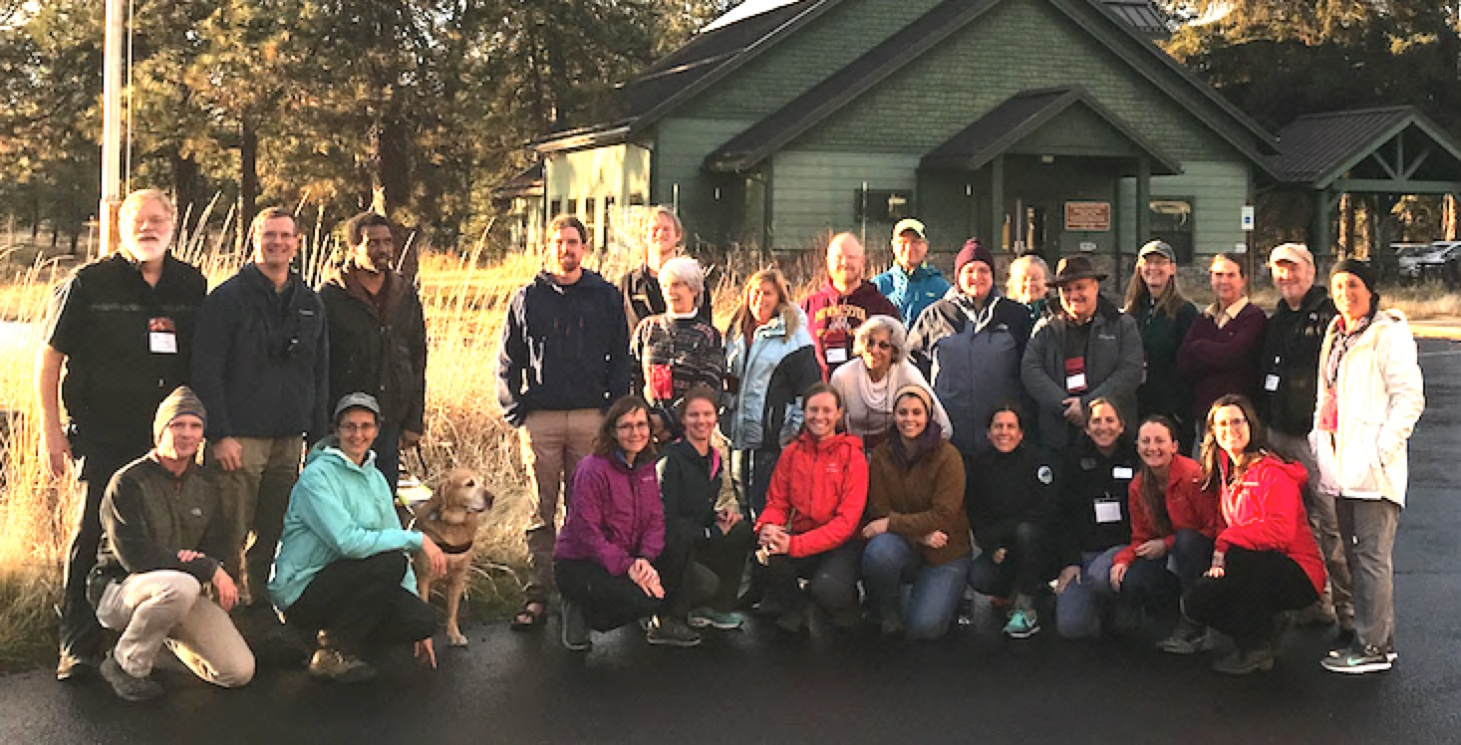

Slide 4
Objectives:
    Not here to “convert”
    Not Team A vs. Team B
    Not political
    Here to “plant a seed”
    Here to be respectful of others’ opinions

Slide 5
Want To Save Some Green?
How do you form your opinions?
What are your sources?
What is your plan?

Slide 6
What is the first vision that pops in your head when I say…

Slide 7
What is the first vision that pops in your head when I say…
CLIMATE CHANGE
or
GLOBAL WARMING

Slide 8
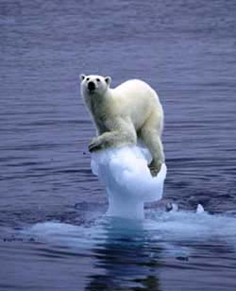
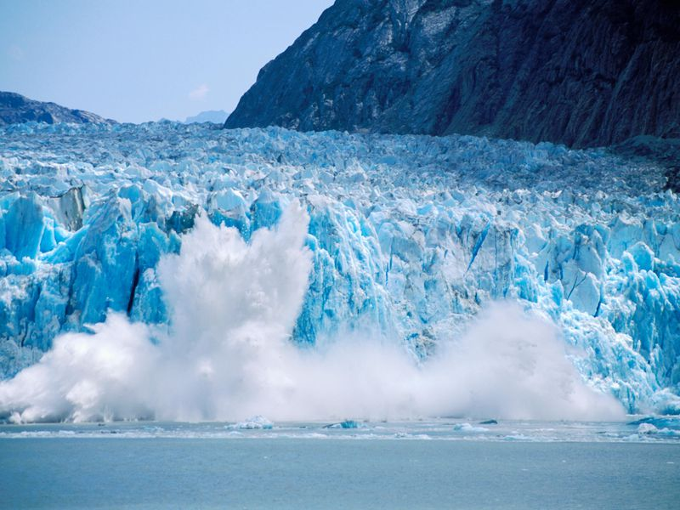
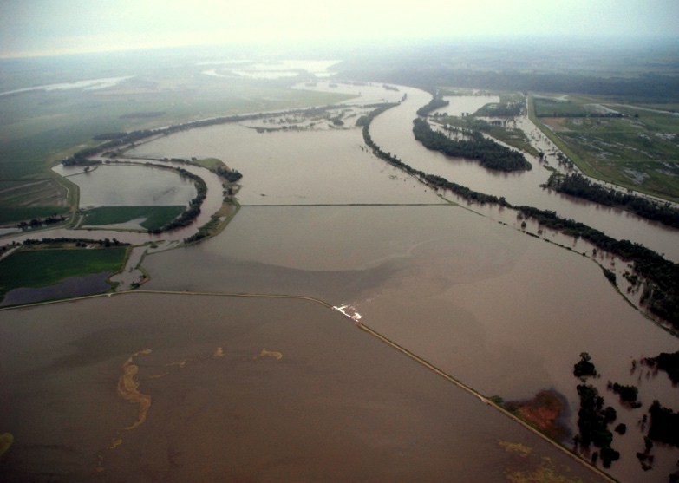
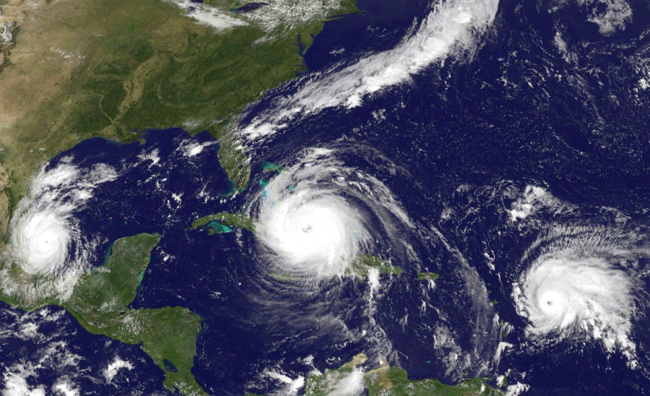
Ice Melting
NPS
Polar Bears
NASA
Extreme Weather
NASA 2017
NASA

Slide 9


2016 Opinion Poll

Slide 10

1.) Do you think global warming is happening?
1.) Estimated % of adults who think global warming is happening
2.) Do you think global warming is mostly caused by human activities?
2.) Estimated % of adults who think global warming is mostly caused
by human activities

Slide 11
69% 1.) Estimated % of adults who think global warming is happening
52% 2.) Estimated % of adults who think global warming is mostly
caused by human activities

Slide 12
3.) Do you think global warming will harm plants and animals?
3.) Estimated % of adults who think global warming will harm
plants and animals

Slide 13
68% 3.) Estimated % of adults who think global warming will harm
plants and animals

Slide 14
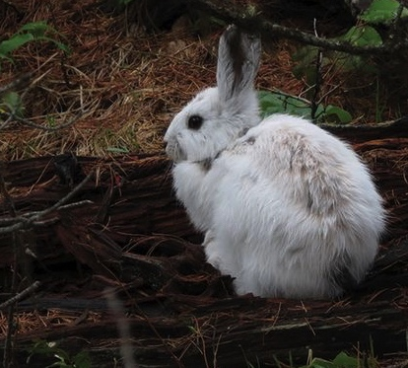
What’s wrong with this picture???

Slide 15
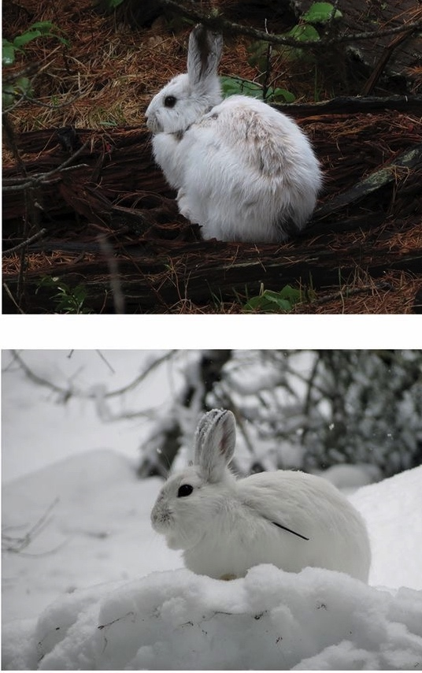
Direct effects of late snow / early spring:
Camouflage mismatch
Some wildlife change color to match snow in winter
As snow-free period increases, animals vulnerable in spring and fall
Weekly survival decrease of 7%
Can they adapt to survive?
Snowshoe hare, Lepus americanus
Mills et al. PNAS 2013, Zimova et al Ecology Letters 2016

Slide 16
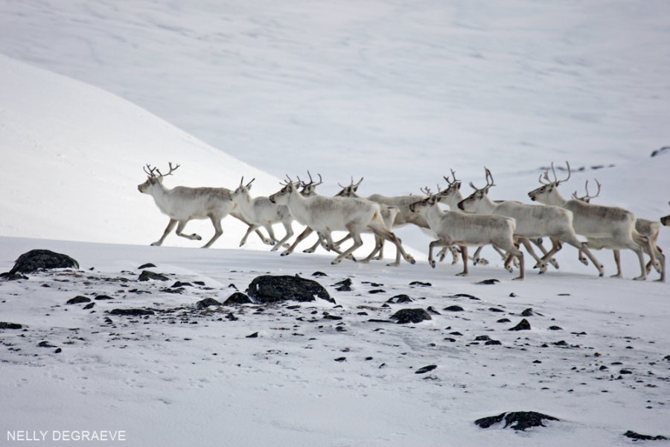
Imagine:
You are a Caribou on migration
looking forward to springtime greens. . .

Slide 17
Trophic mismatch: Lack of synchrony between the phenology of consumers and that of their resources
Caribou in Greenland
(Post and Forchhammer 2008)
Plant emergence date driven by temperature
Caribou migrate to calve in areas of high productivity
Reproduction decreased 4-fold because Caribou missed peak green-up
Caribou (Rangifer tarandus)
Notes:
Climate change reduces reproductive success of
an Arctic herbivore through trophic mismatch
Eric Post1,2,* and Mads C. Forchhammer2,3

Slide 18
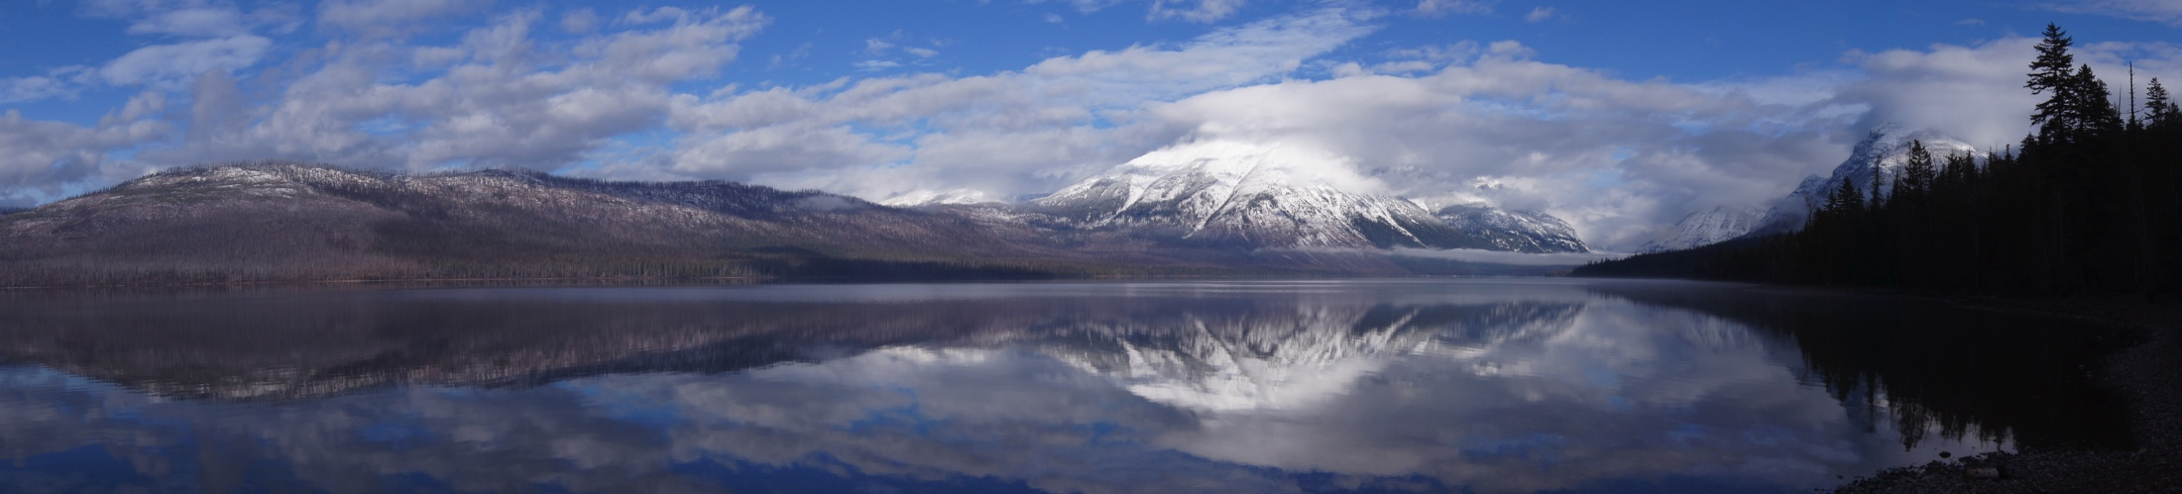
Glacier National Park, Montana
Aaron Jungbluth
In 1850, GNP had 150 glaciers
Increased melting since 1980
Estimated all glaciers melt by 2030
Limits fresh water for animals
Negatively warms lakes and rivers for aquatic life

Slide 19
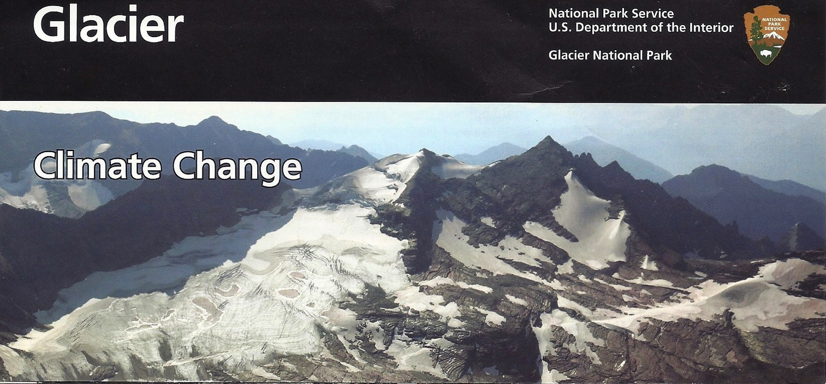
Do we need to change the name of Glacier National Park?

Slide 20
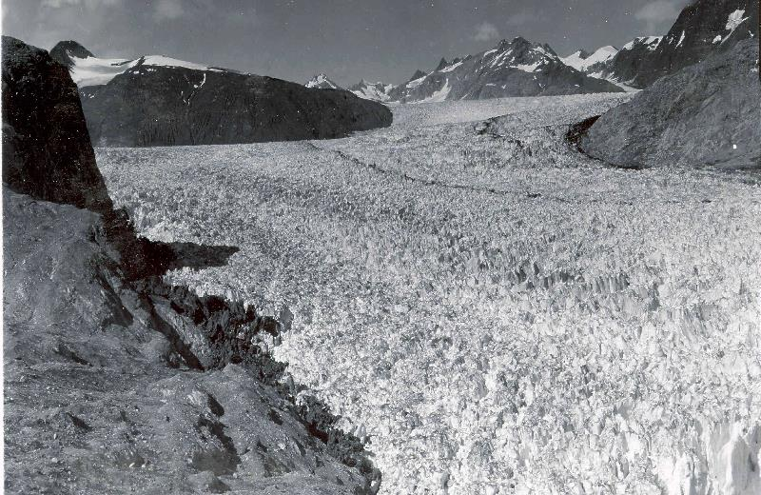
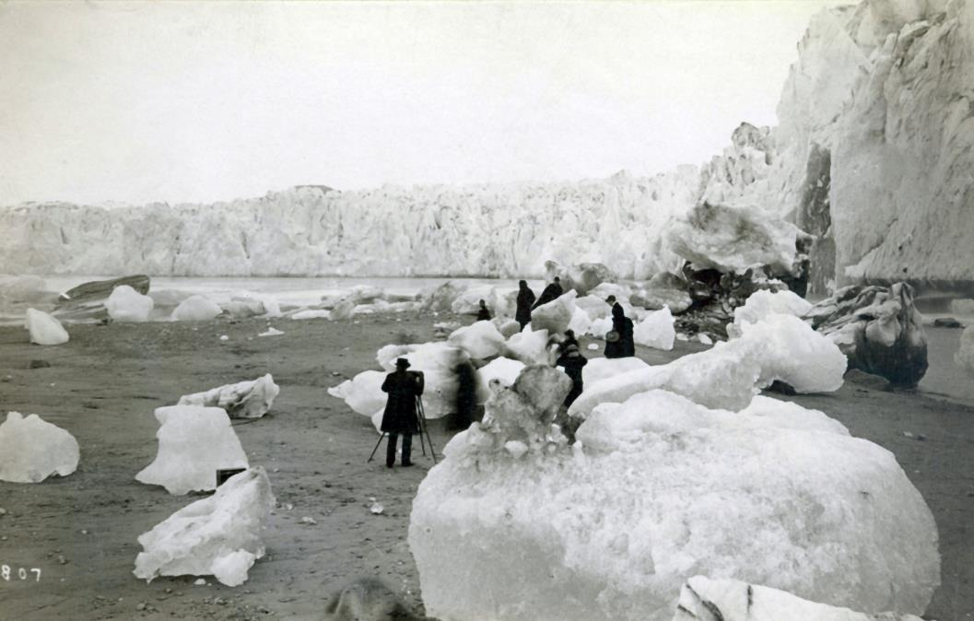
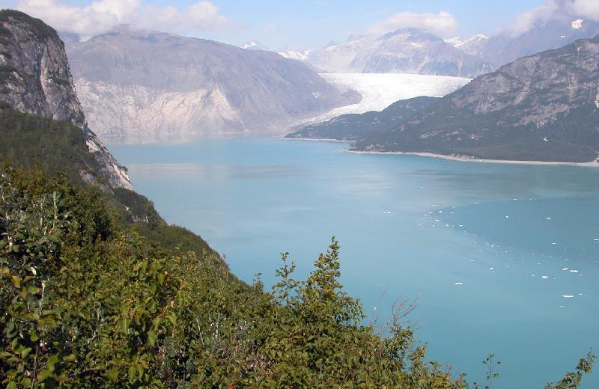
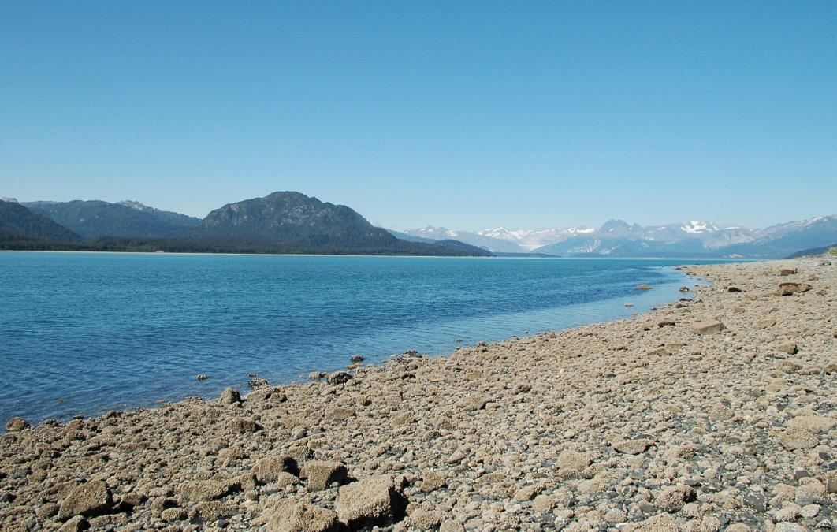
Muir Glacier – Glacier Bay, Alaska
Muir Glacier – Glacier Bay, Alaska
1941
1880s
2005
2004
Notes:
Muir Glacier – GLBA (both sets)
http://www.usgs.gov/climate_landuse/glaciers/repeat_photography.asp

Slide 21
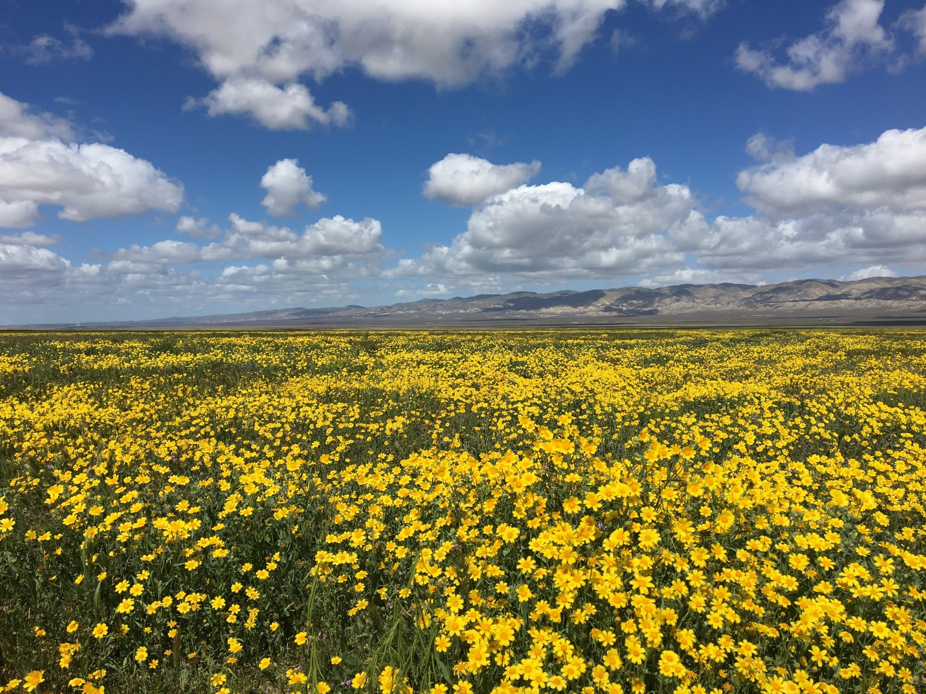
A Change With a Twist:
Carrizo Plain Ecosystem Project (CPEP)

Slide 22
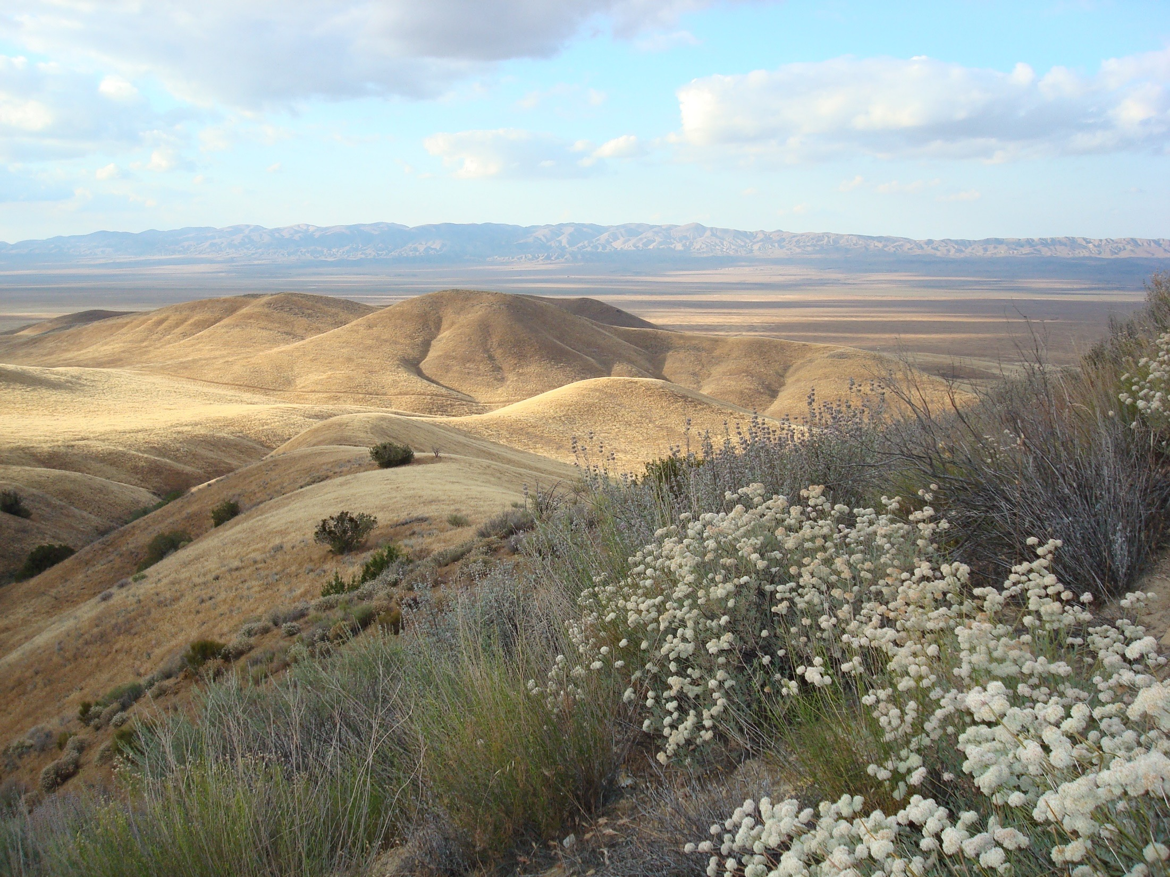
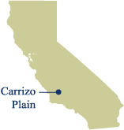
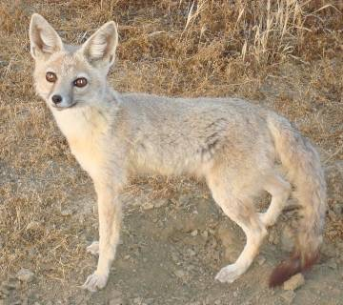
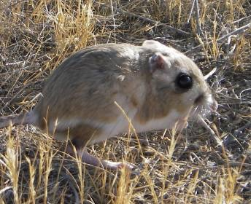
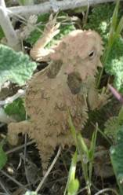
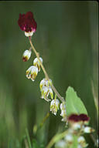
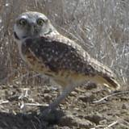
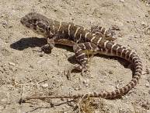
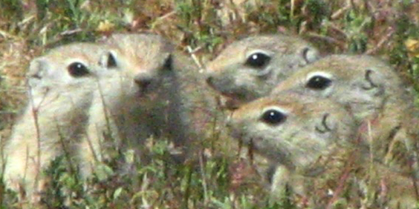
Carrizo Plain National Monument
Largest remnant of San Joaquin Valley grassland ecosystem (1,000 km²)
John Roser
Alison Cleary
Notes:
I’d like to give you some quick background information about this area and the project. The Carrizo Plain, where this study occurs, is the largest remnant of the San Joaquin grassland ecosystem which historically occurred throughout the central valley of California but has been converted to intensive agriculture. The Carrizo is a key conservation area for approximately 30 threatened and endangered species that are included in the 2nd largest USFWS multi-species recovery plan; only the recovery plan for south florida includes more species. Although the giant kangaroo rat is federally endangered, like many of these species, they are abundant in the Carrizo, which is one of their last strongholds. With so many imperiled species at every trophic level, such as the giant kangaroo rat, san joaquin kit fox, blunt nose leopard lizard, california jewelflower, horned lizard, and burrowing owl, there is great potential for management actions aimed at one species to inadvertently harm another sensitive species through direct or indirect food web pathways. One of the main goals of my study is to map out the food web interactions in this system to help with management efforts there.

Slide 23
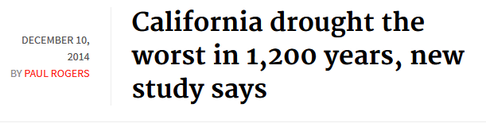
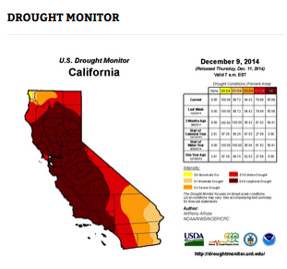
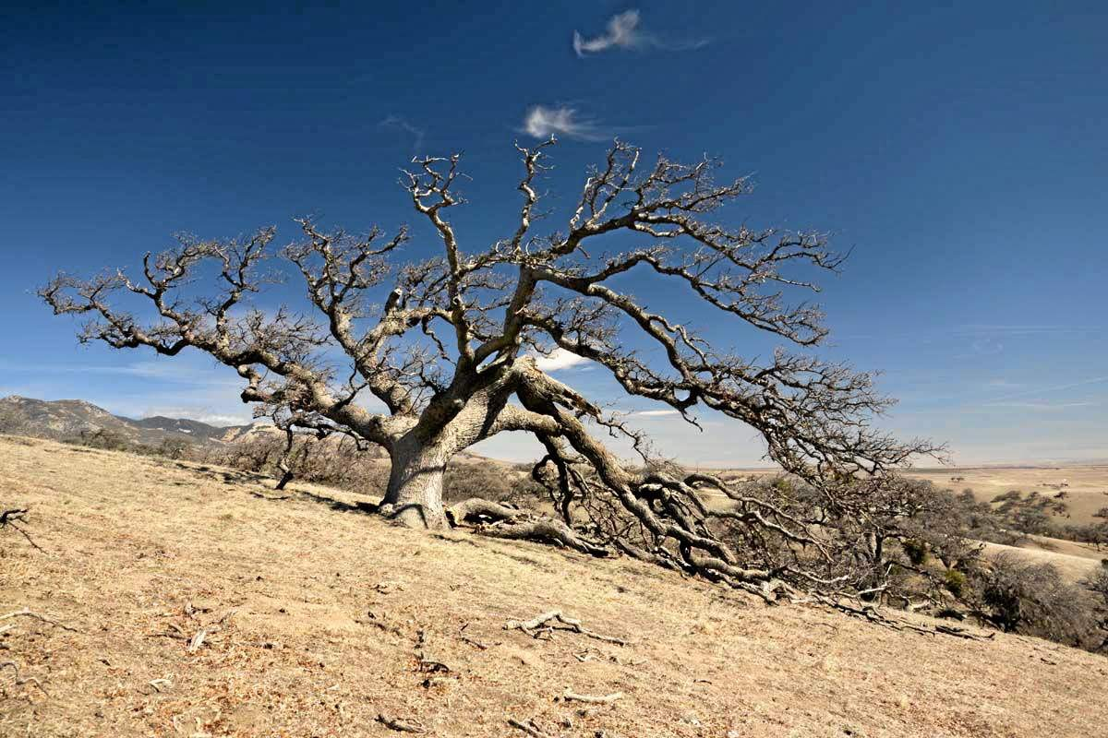
Griffin & Anchukaitis Geophys Res Lett 2014
Notes:
Although we’ve documented strong system-wide effects of GKR, we’ve also seen that precipitation levels really drive this system. You’ve probably heard about the extended drought in California, and a new study in Geophysical Research Letters looked at tree ring data and concluded that this has been the worst drought in 1200 years.
Daniel Griffin and Kevin J Anchukaitis, UMN

Slide 24
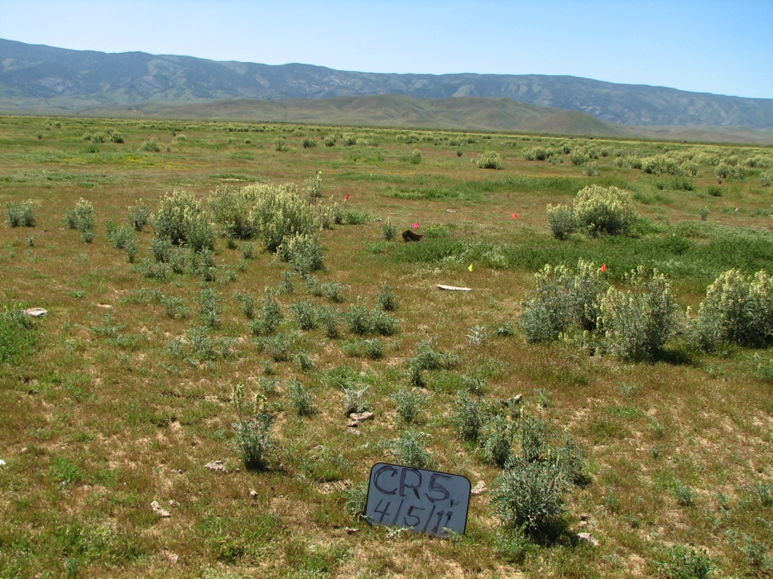
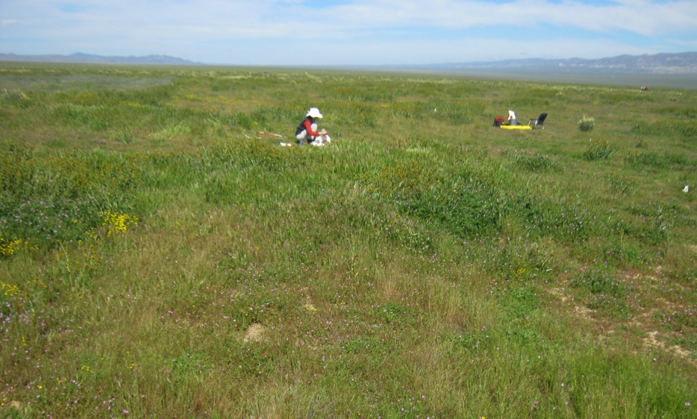
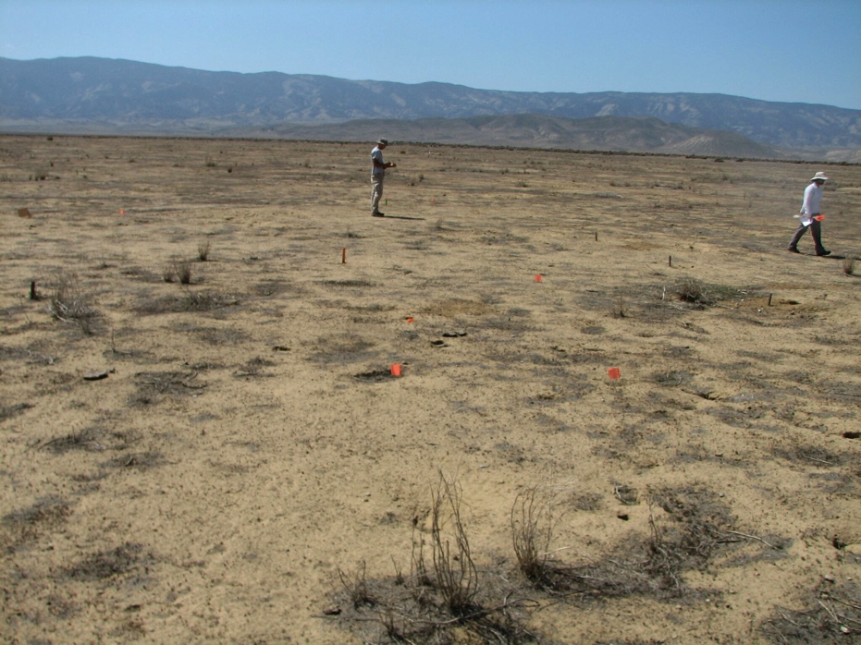
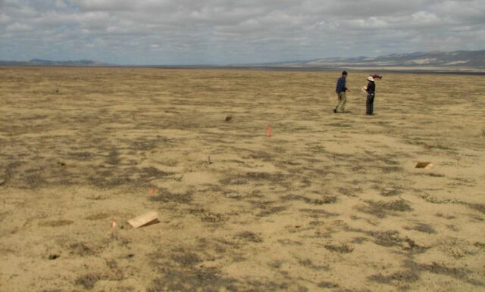
Drought Transformed the Landscape
Spring 2011
Spring 2011
Spring 2014
Spring 2014

Slide 25
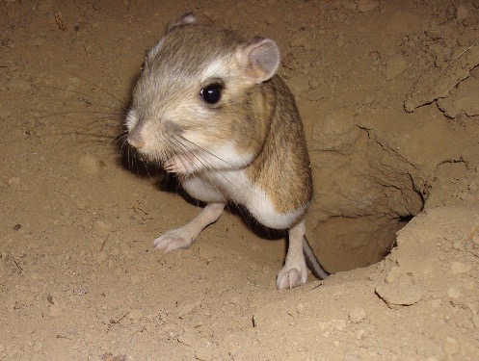
Response of a keystone species:
The Giant Kangaroo Rat
Drought
# of Rats / Hectare
Plants were able to recover on their own when the rains came back
What is the limit?

Slide 26
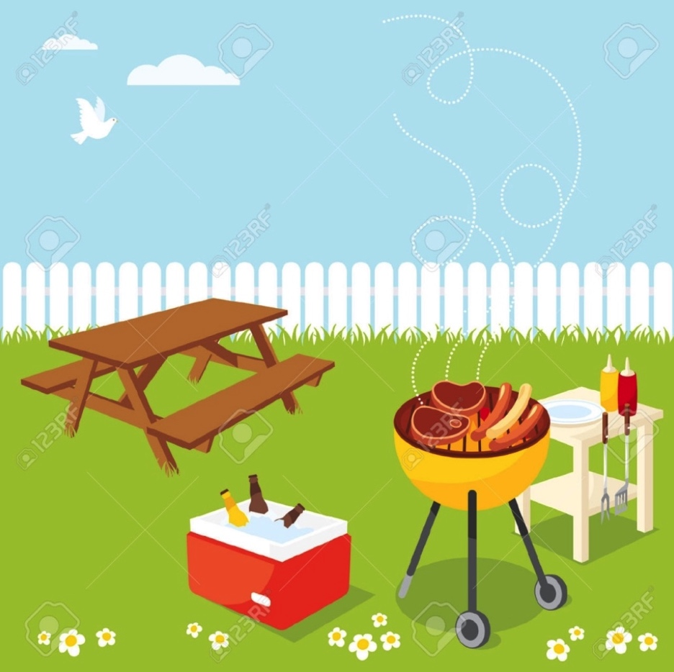
Have you noticed any changes in your own backyard?

Slide 27
4.) Do you think global warming will harm you personally?
4.) Estimated % of adults who think global warming will harm them personally
5.) Do you think global warming will harm people in the United States?
5.) Estimated % of adults who think global warming will harm people in the U.S.
6.) Do you think global warming will harm people in developing countries?
6.) Estimated % of adults who think global warming will harm people in
developing countries

Slide 28
38% 4.) Estimated % of adults who think global warming will harm
them personally
56% 5.) Estimated % of adults who think global warming will harm
people in the U.S.
61% 6.) Estimated % of adults who think global warming will harm
people in developing countries

Slide 29
Planting Zones
5
6
7

Slide 30
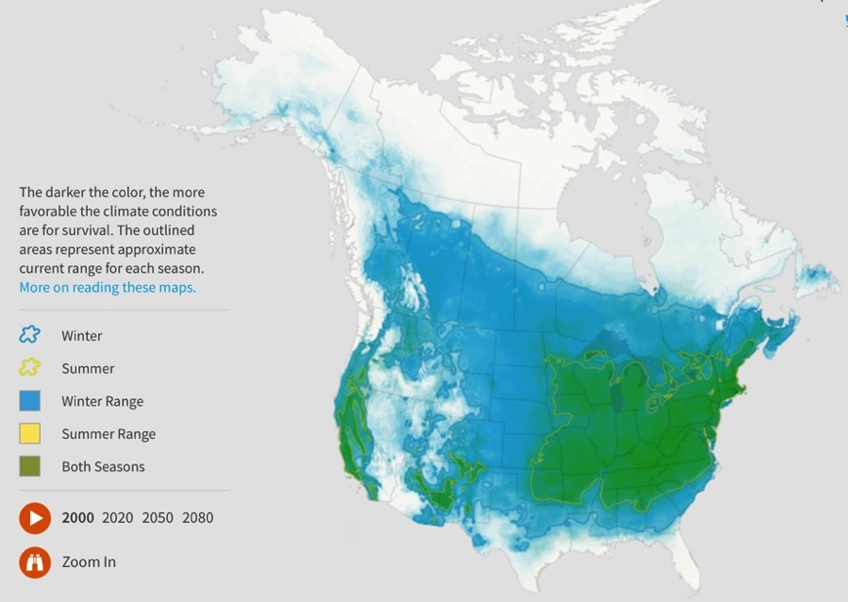
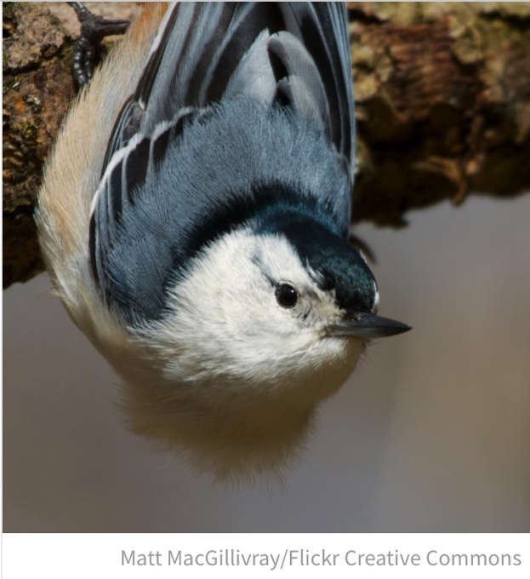
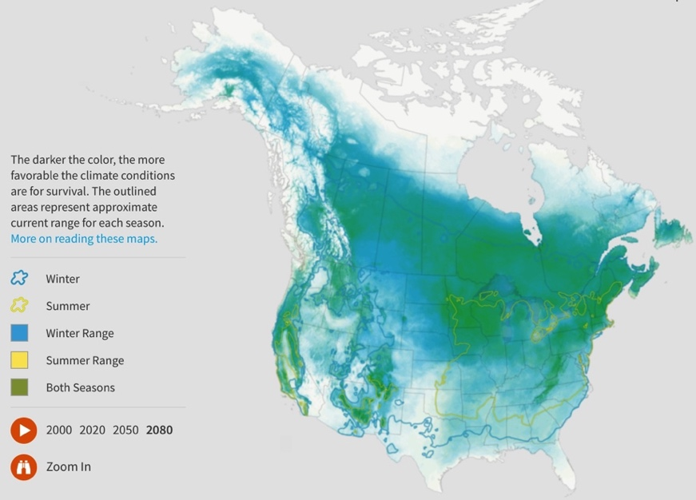
Bird Habitat Shifts
National Audubon Society - Study of 314 Species
Recorded Data
2000
Prediction
2080
Handout of Citizen Scientist Project
Opportunities later. . .

Slide 31
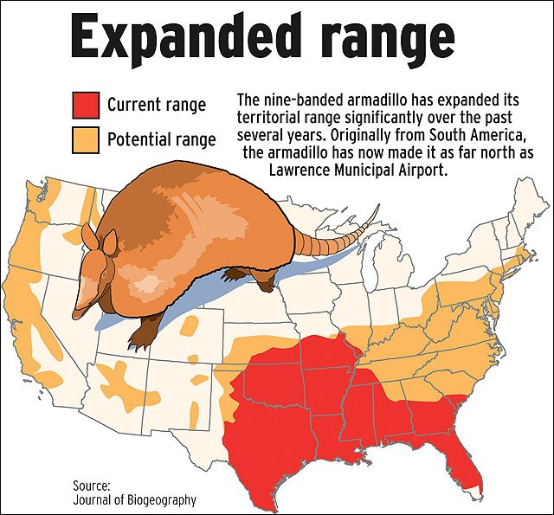
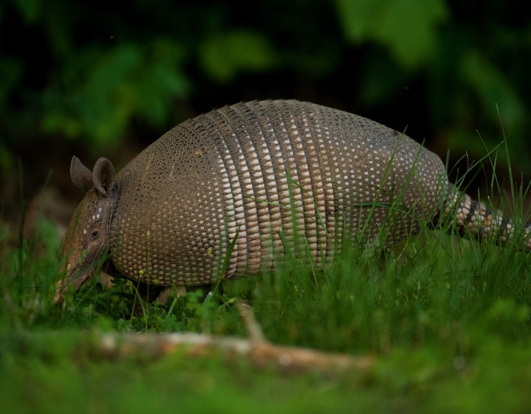
Nine-banded Armadillo

